Slide 1
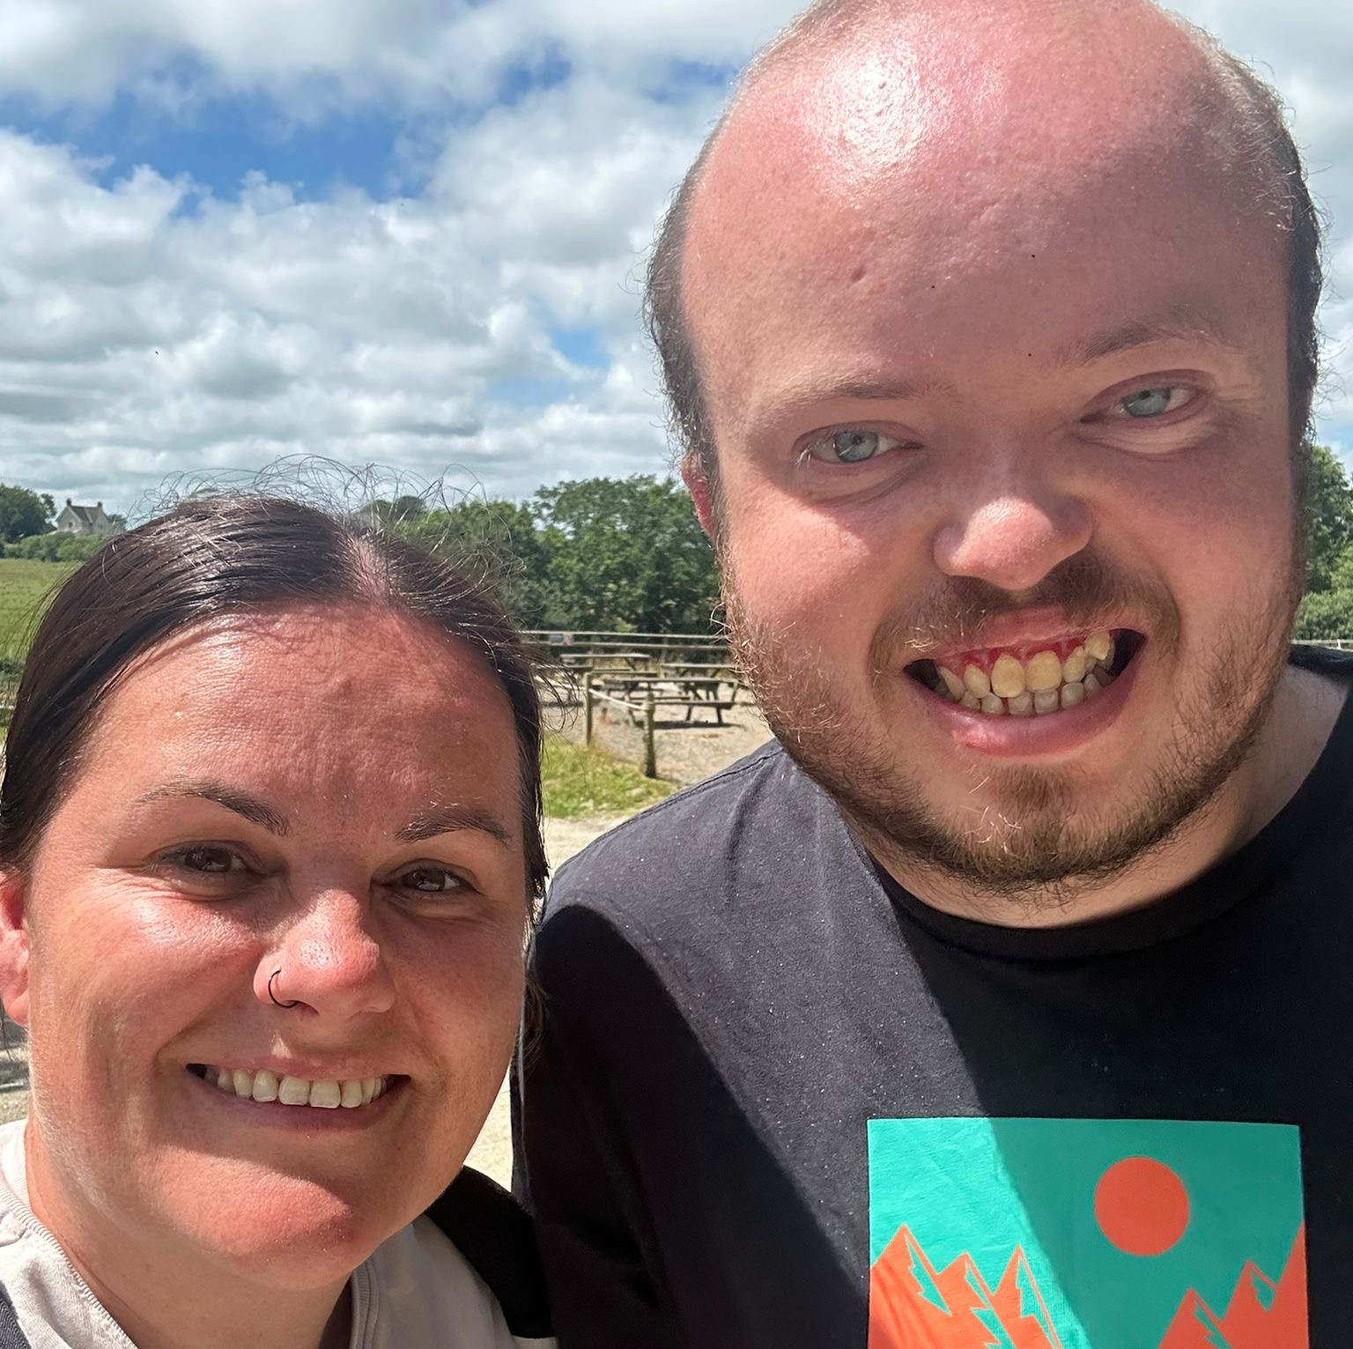
Kieran and Jenna’s Manor Park Adventure
Big Smiles!
3/7/26
All photographs taken by JMA, BLOG written by CA.

Slide 2
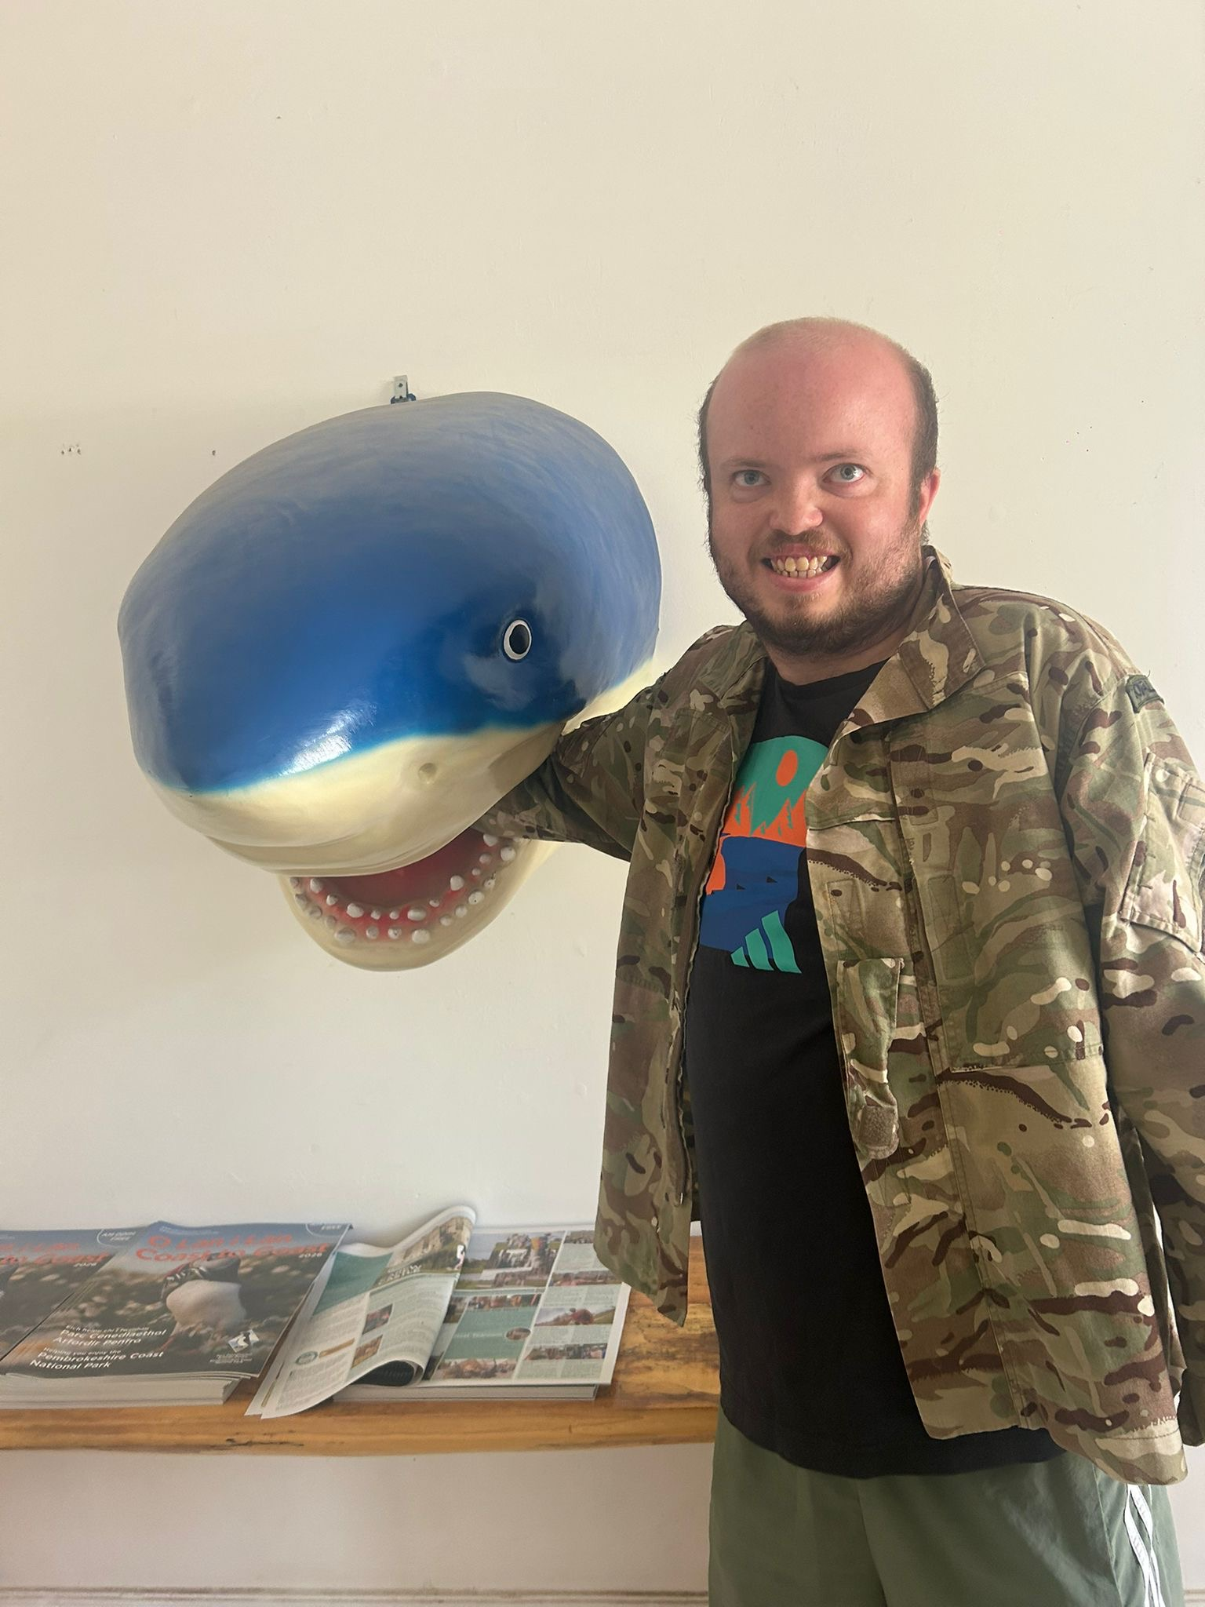
On 3rd July 2026 Kieran and Jenna set off on an adventure to Manor Park.
Kieran and Jenna visited many animals including a shark….
No Kieran’s were harmed for this photo.

Slide 3
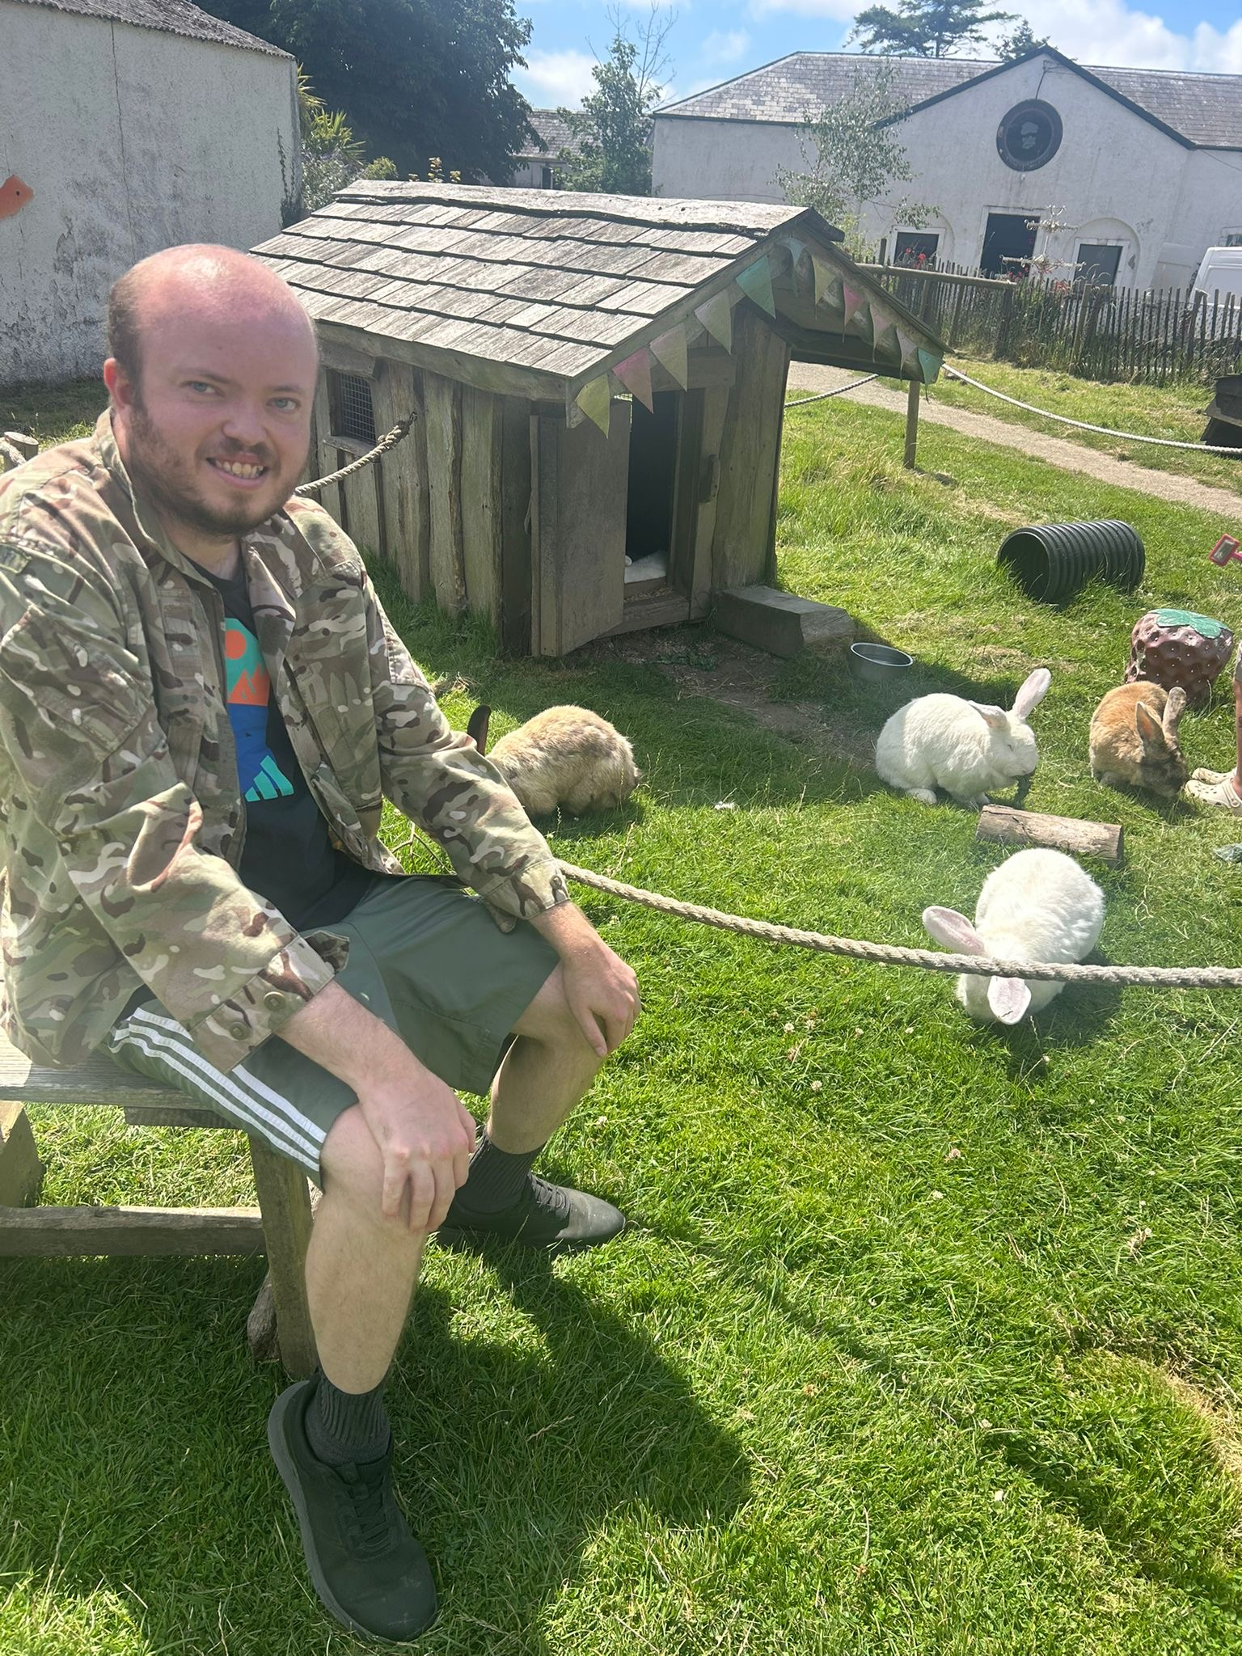
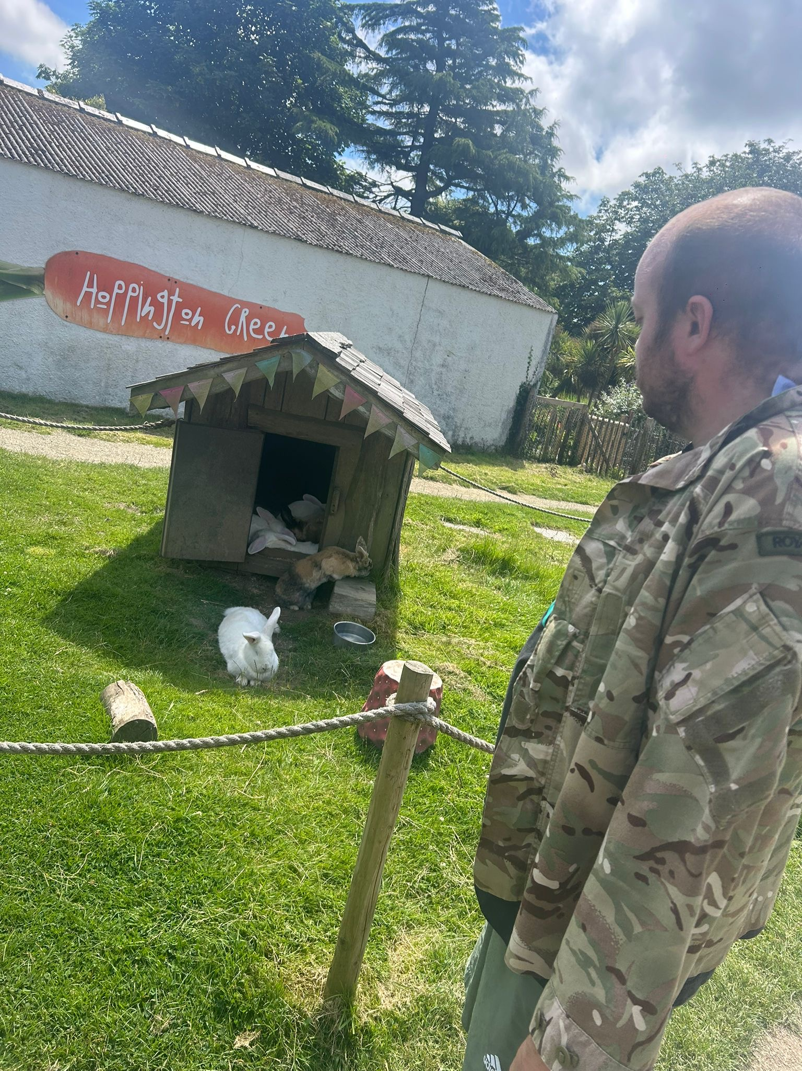
Manor Park has some great zoo/exotic animals however Kieran managed to find some familiar friends of his there…

Slide 4
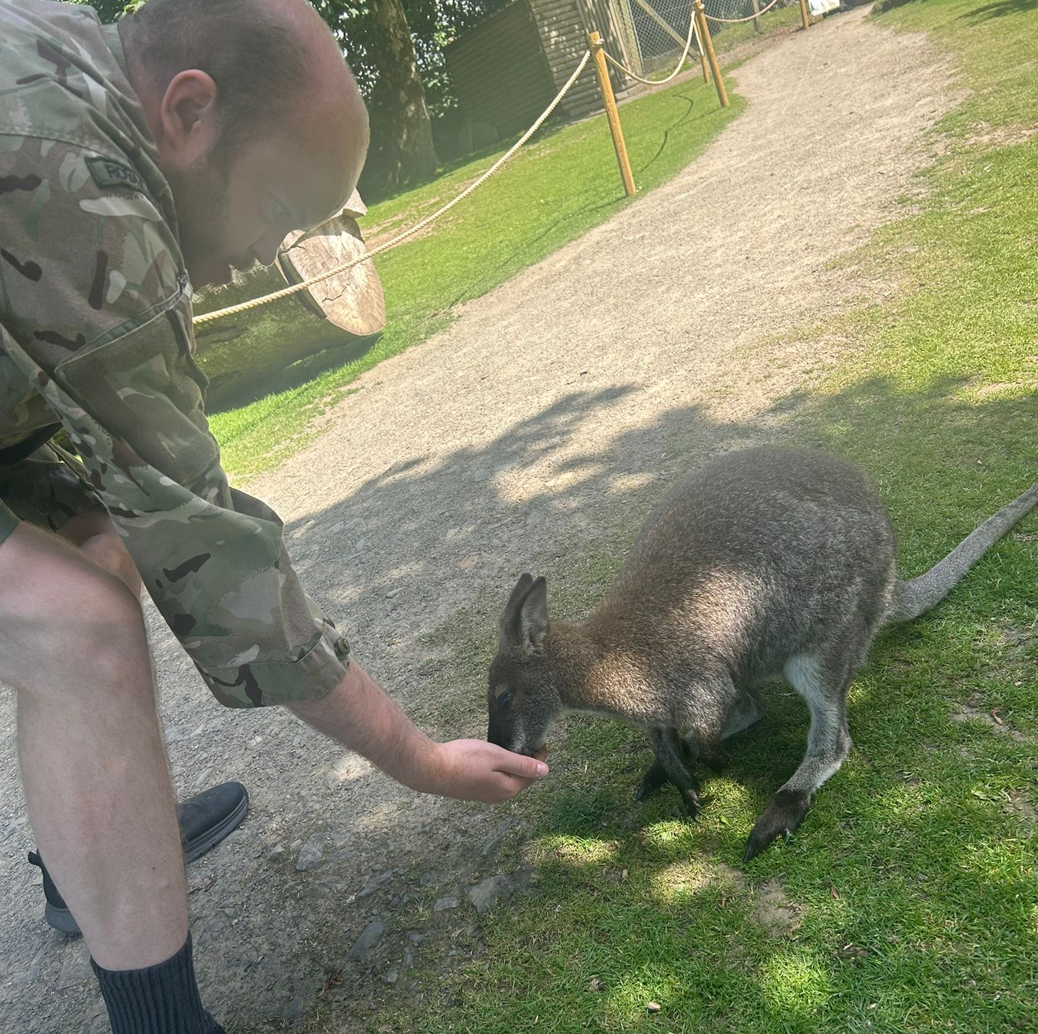
Did somebody say, “Good’ay Mate”?
Kieran fed a very loveable Wallaby!
Wallaby's are closely related to Kangaroos but are more compact with shorter legs and usually smaller!

Slide 5
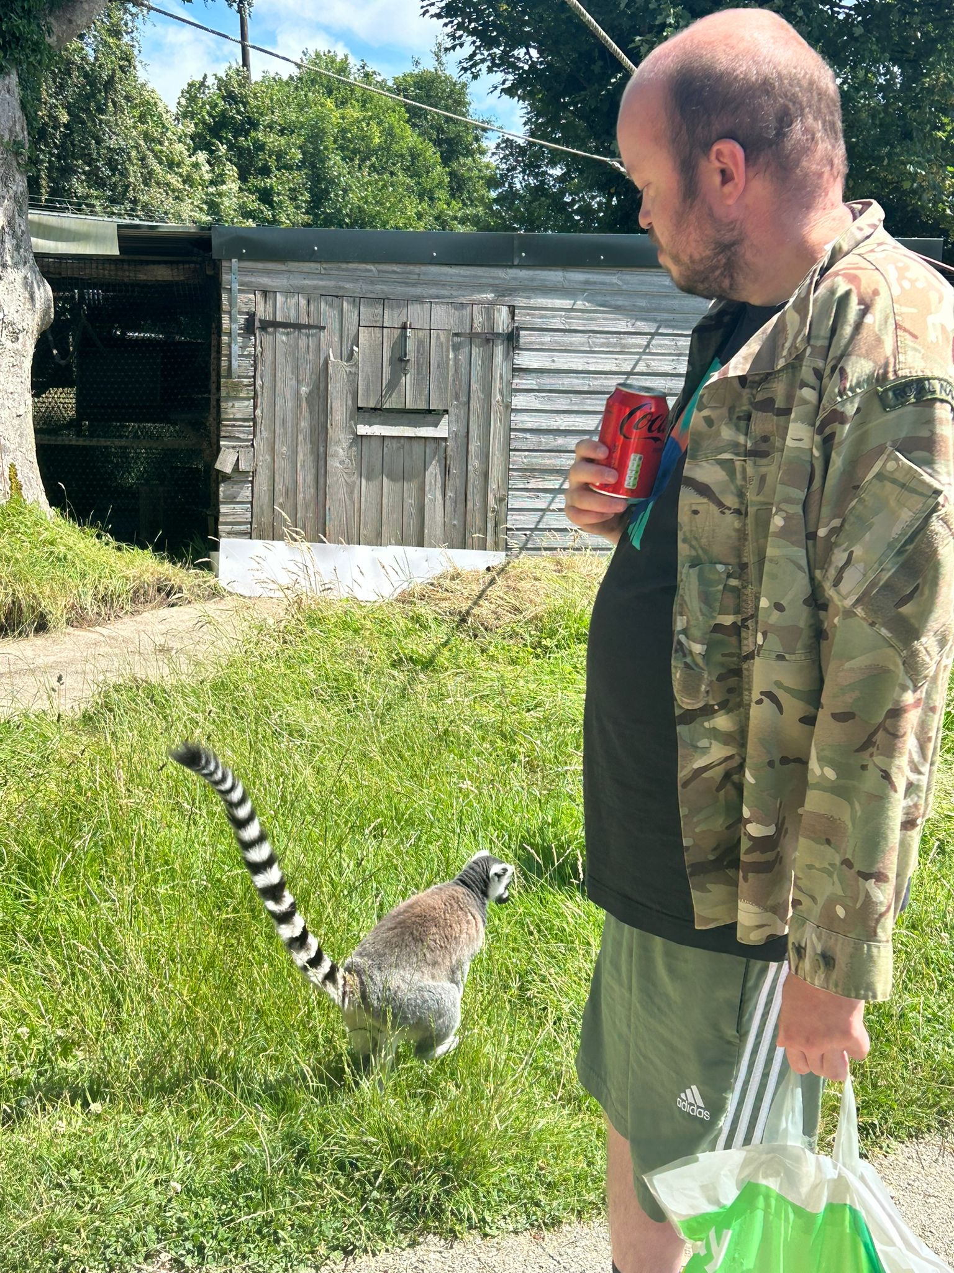
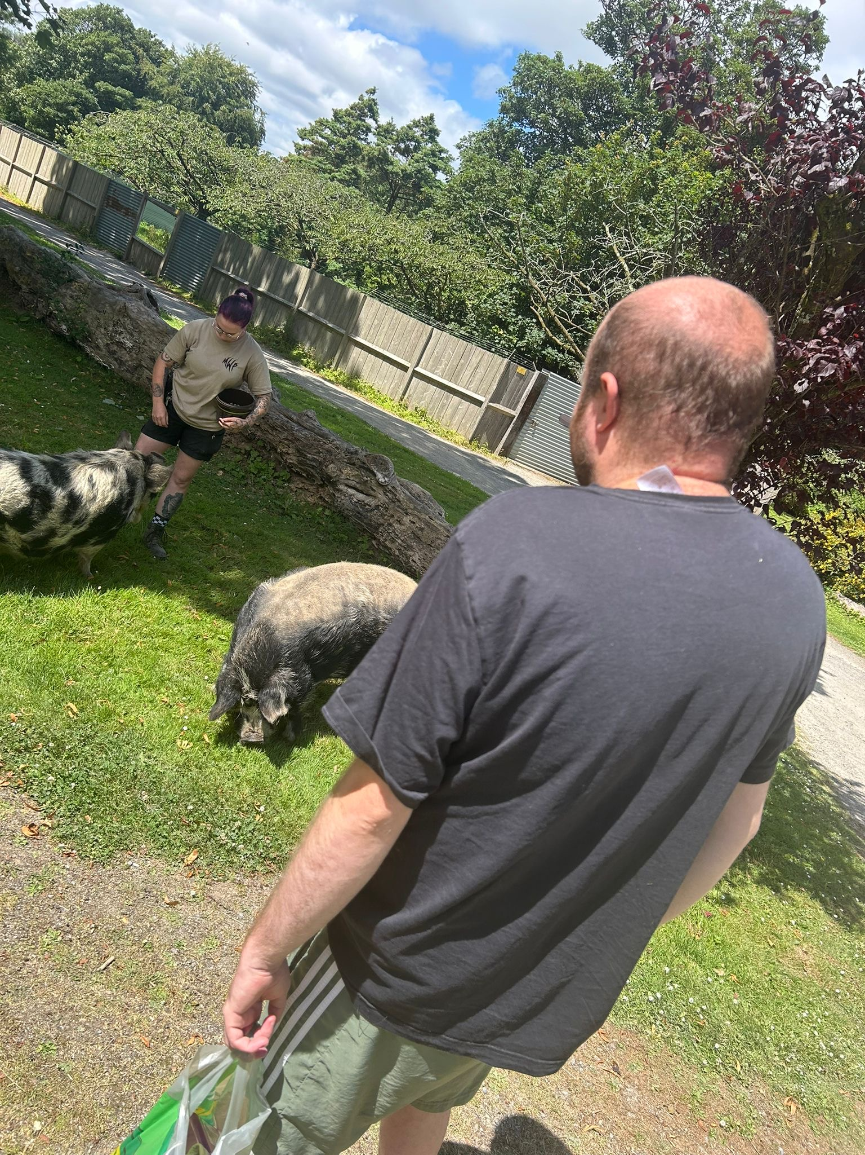
These are Kunekune Pigs!
This is a ring-tailed Lemur!

Slide 6
Overall Kieran and Jenna really enjoyed their day out to Manor Park! From seeing exotic animals to more recognisable friends Manor Park was a great experience!
At Gelli Aur Care Ltd we encourage Residents to participate in activities that improve their knowledge, self-esteem and overall wellbeing!
Jenna did a great job of Supporting Kieran to ensure all medication was given and any relevant support needed was given throughout the day!

