Slide 1
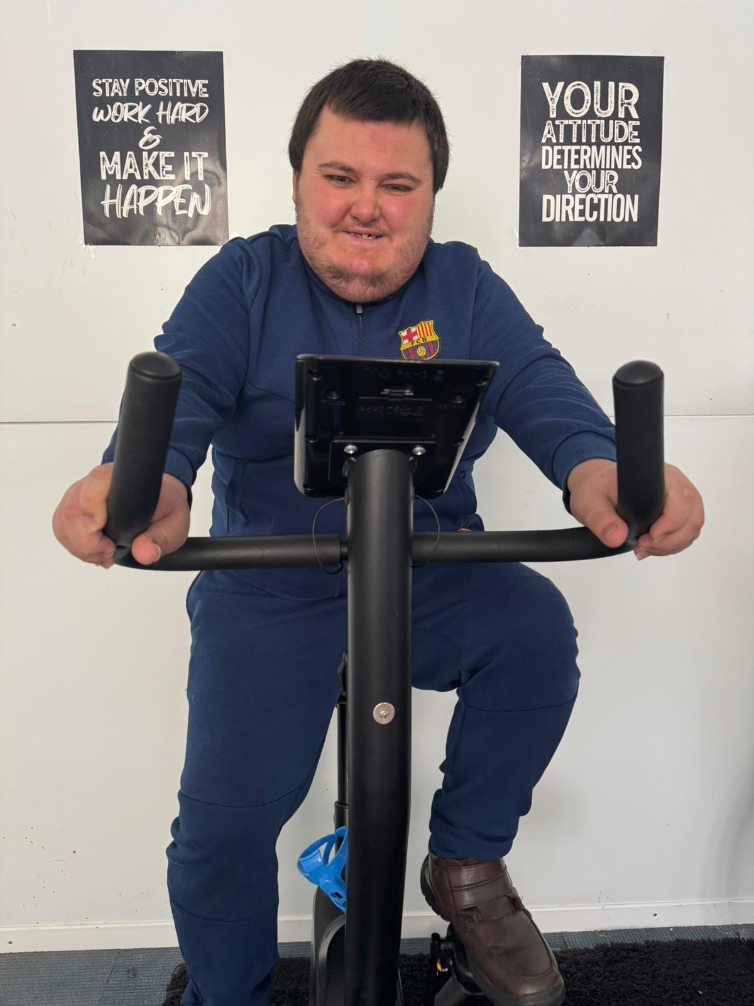
Daniel’s day in the Gym
15/5/26

Slide 2
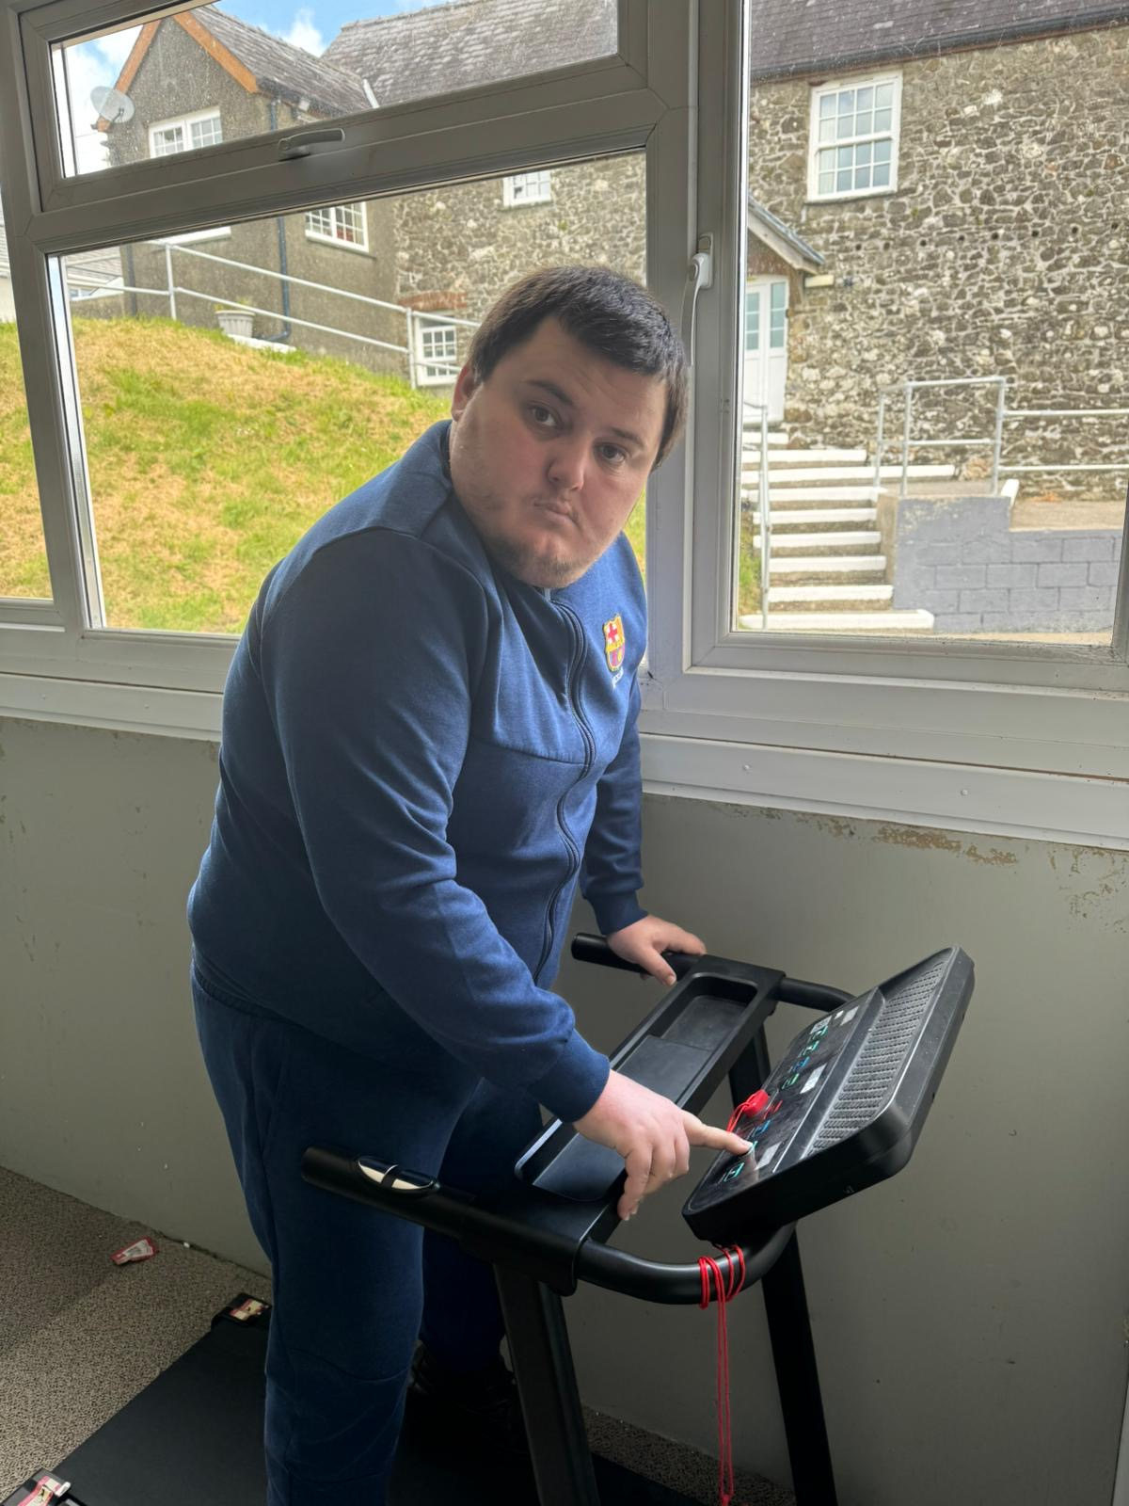
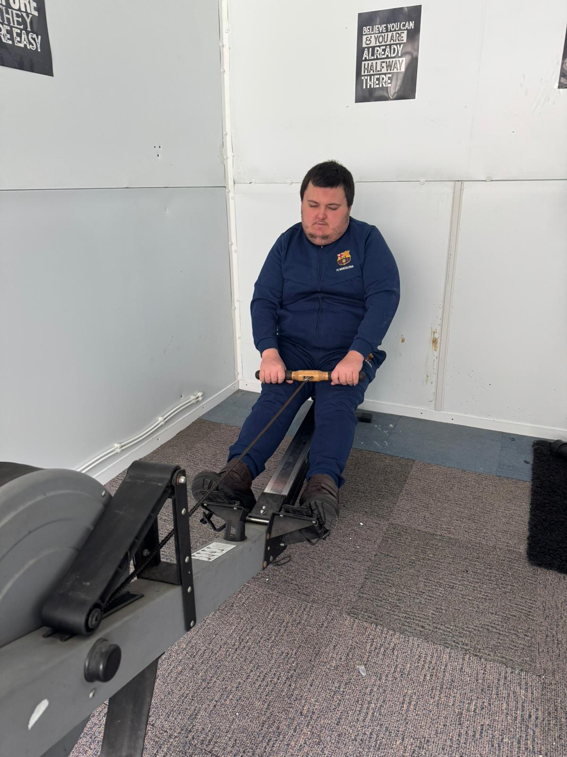
On 15/5/26 Daniel and Andy used the on-site Gym to move their bodies.
Daniel used many apparatus in the gym and enjoyed having his workout photographed by Andy!

Slide 3
From photographic evidence, Daniel enjoyed the bike apparatus the most!
Big smiles!

Slide 4
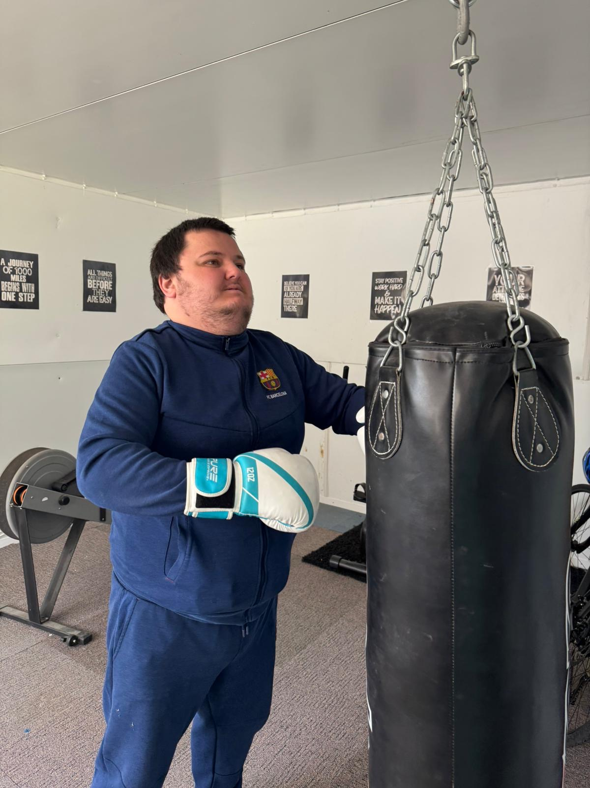
In one corner we have…
Daniel finished off his workout with the punch bag!

Slide 5

Having easy access to fitness equipment encourages regular physical activity, which supports physical health, mental well-being, stress reduction and better sleep.
The residents have access to the gym whenever suitable to them.
We are honoured to supply this to our residents.

