Slide 1

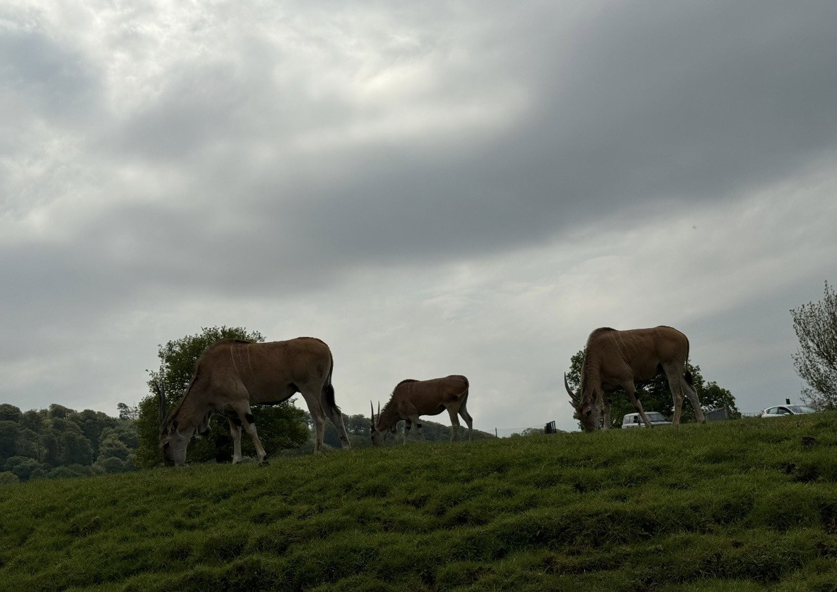
Max’s Birthday at Longleat 2026
BLOG written by Chloe Ashley and Max Collins-Smith

Slide 2
30th April 2026
On Max’s 30th Birthday he woke up, got ready and headed out with Andy for their long journey of three hours! On the way to Longleat Andy stopped at a services and ordered a Caramel Macchiato, Max tried this drink and loved it!
Once arriving at Longleat Max and Andy headed straight in and wondered the grounds. Max found the forbidden maze. Longleat's maze consists of over 16,000 trees and takes around 20-30 minutes to walk through. However, Max got lost but Andy managed to help find a way out!

Slide 3
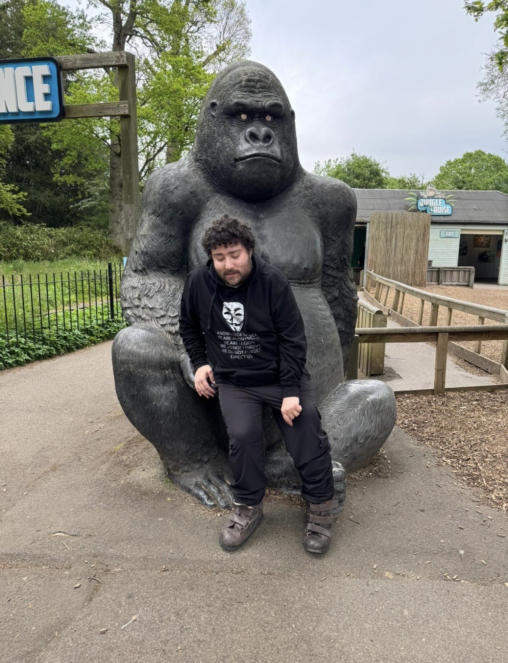
30th APRIL 2026
After the maze, Max went to the café to have a drink as he was exhausted from his long journey and the maze! Max enjoyed a refreshing coke accompanied by a tiramisu cake! Yum!
Max and Andy did try to go to the drive through safari however it was shut on this occasion!
Then Max and Andy Tesco to buy some travel headphones to keep occupied in the hotel room!

Slide 4
30th April 2026
After a long day of travelling Max and Andy headed to their hotel to settle for the evening. Max and Andy grabbed a few drinks from the vending machine to keep satisfied during the night!
Andy and Max had a deal with their hotel and had a dinner and dessert! Max had a big stack burger and for dessert Max had a serving of Biscoff pancakes!
Then straight to bed to prepare for another exciting day at Longleat!

Slide 5
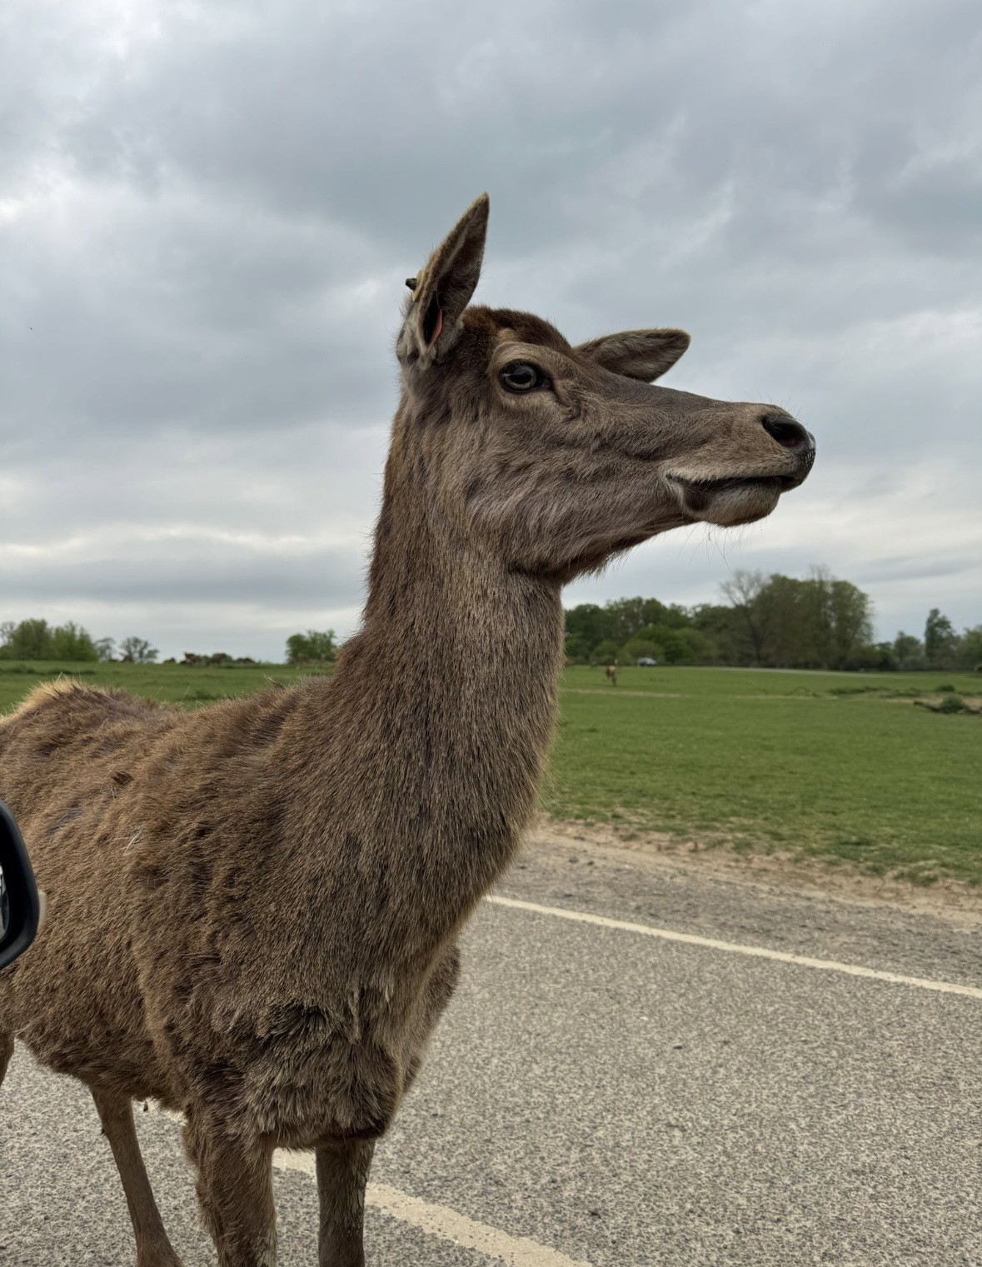
1st may 2026
Max and Andy had breakfast at their hotel, Andy had five plates of food! Making most of the buffet!
Then Andy and Max went to Longleat and did the drive through safari! Max fed the deer from his hand! Lots of sloppy kisses!
Andy and Max made the brave idea to go through the monkey section of the drive through safari. The naughty monkeys stole the jet wash jets off the car!

Slide 6
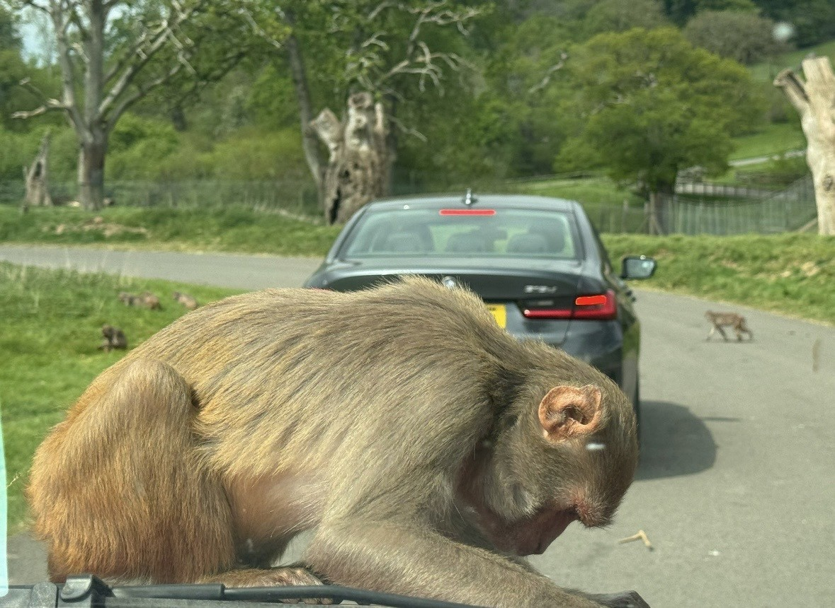
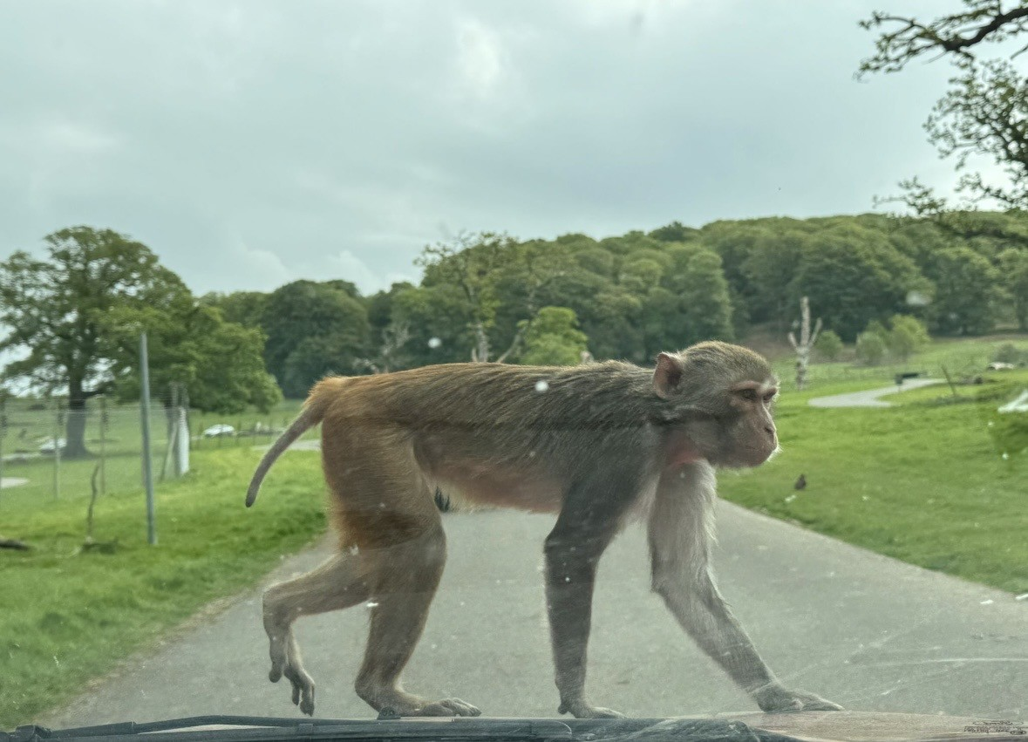

Slide 7
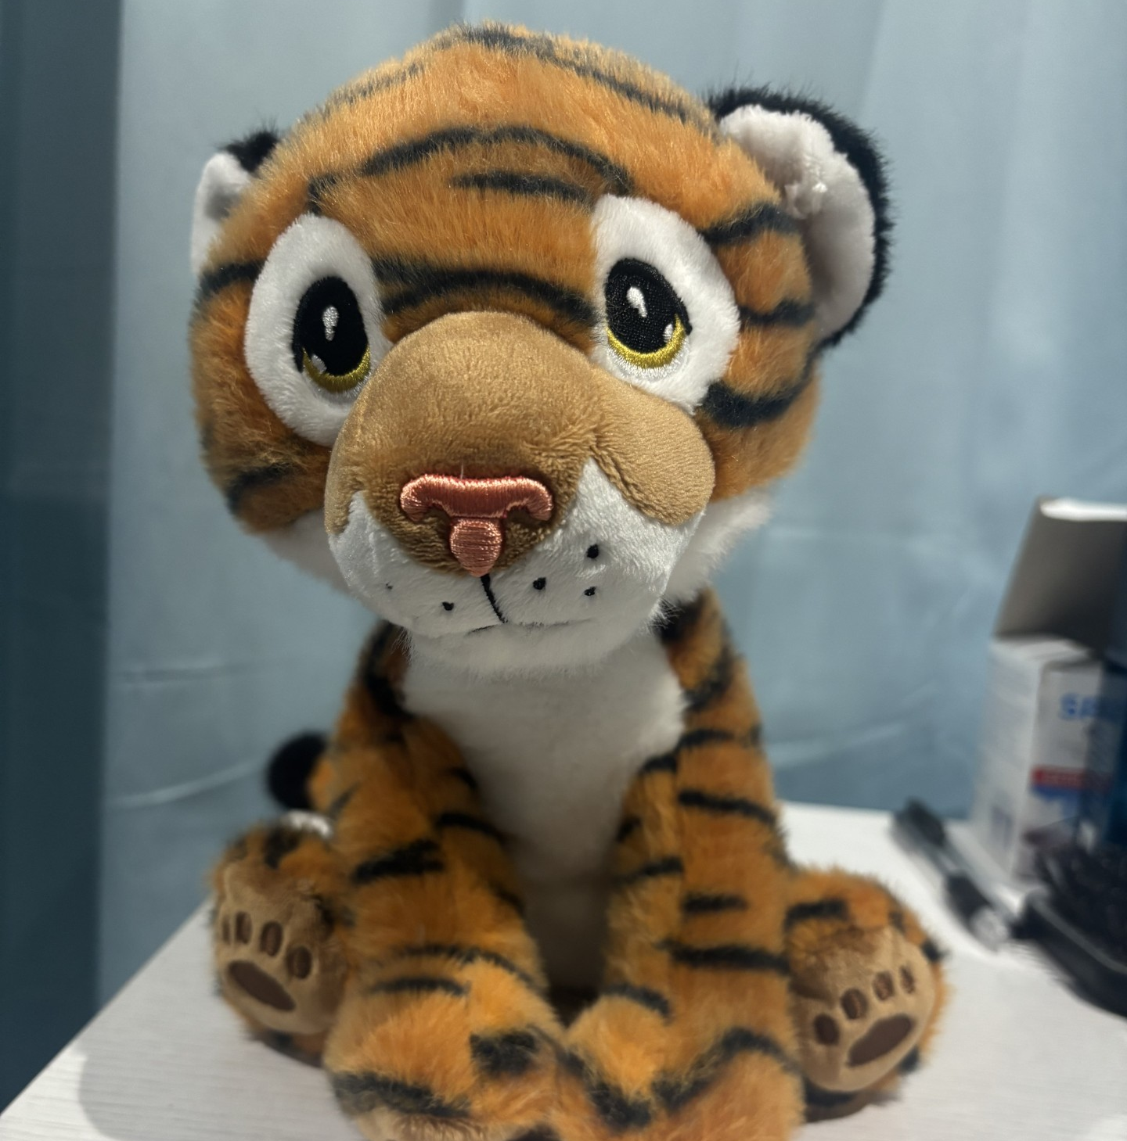
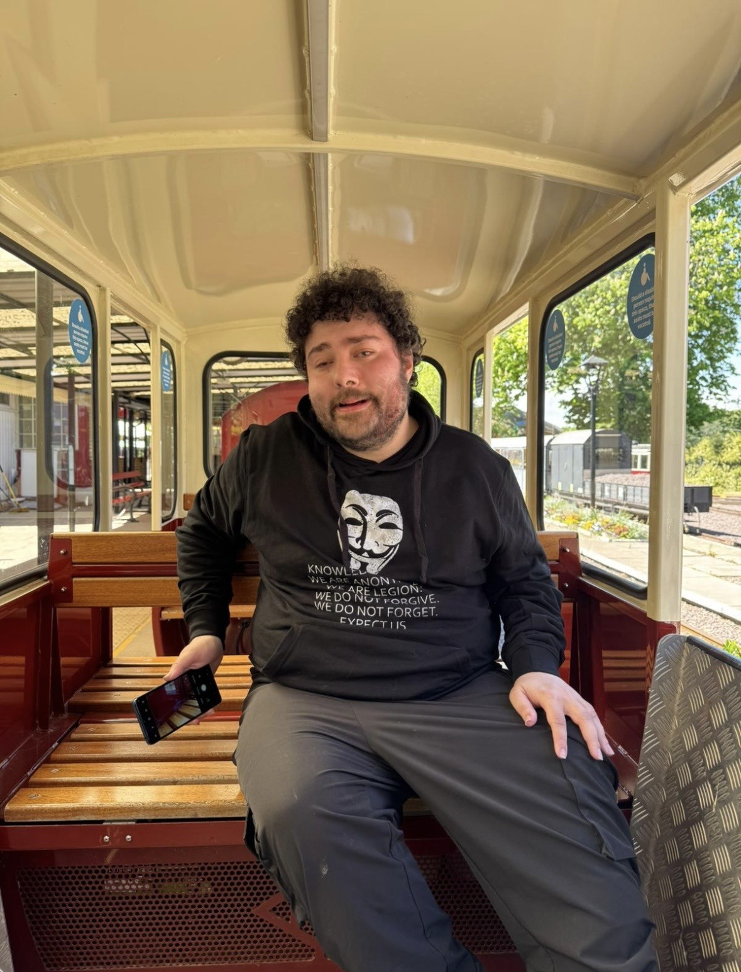
1st may 2026
After the drive through safari Max and Andy got some refreshments!
Max went for a boat trip and fed some sea lions a handful of fish!
After the boat trip Max went onto the Safari train!
Then a well-deserved trip to the Longleat giftshop to buy a lovely tiger plush!
Then it was time to go back to Gelli Aur Care!

Slide 8
1ST MAY 2026
On the way home Max and Andy stopped at Starbucks and enjoyed a refreshing drink of Grande caramel macchiato with oat milk. Yum!
In the evening on the way home Max and Andy stopped at Burger King for dinner and Max had 20 chicken fries and 20 jalapeno bites! Although Max got full after eating the chicken fries and a handful of jalapeno bites, therefore took the rest home.
Andy and Max arrived at Gelli Aur Care around 9:30pm!
A great trip exhausted Max and he headed straight to bed!

Slide 9
Max’s favourite experience
Enjoyed meeting the staff at Longleat
The food was delicious
Seeing many exotic animals
Being lost in the maze was enjoyable, Max was hoping the security would have to save the day!
Note to Andy, Ashley and Barry from Max:
“Thank you Andy for driving me and thank you to Ashley and Barry for organising it.”

