Slide 1
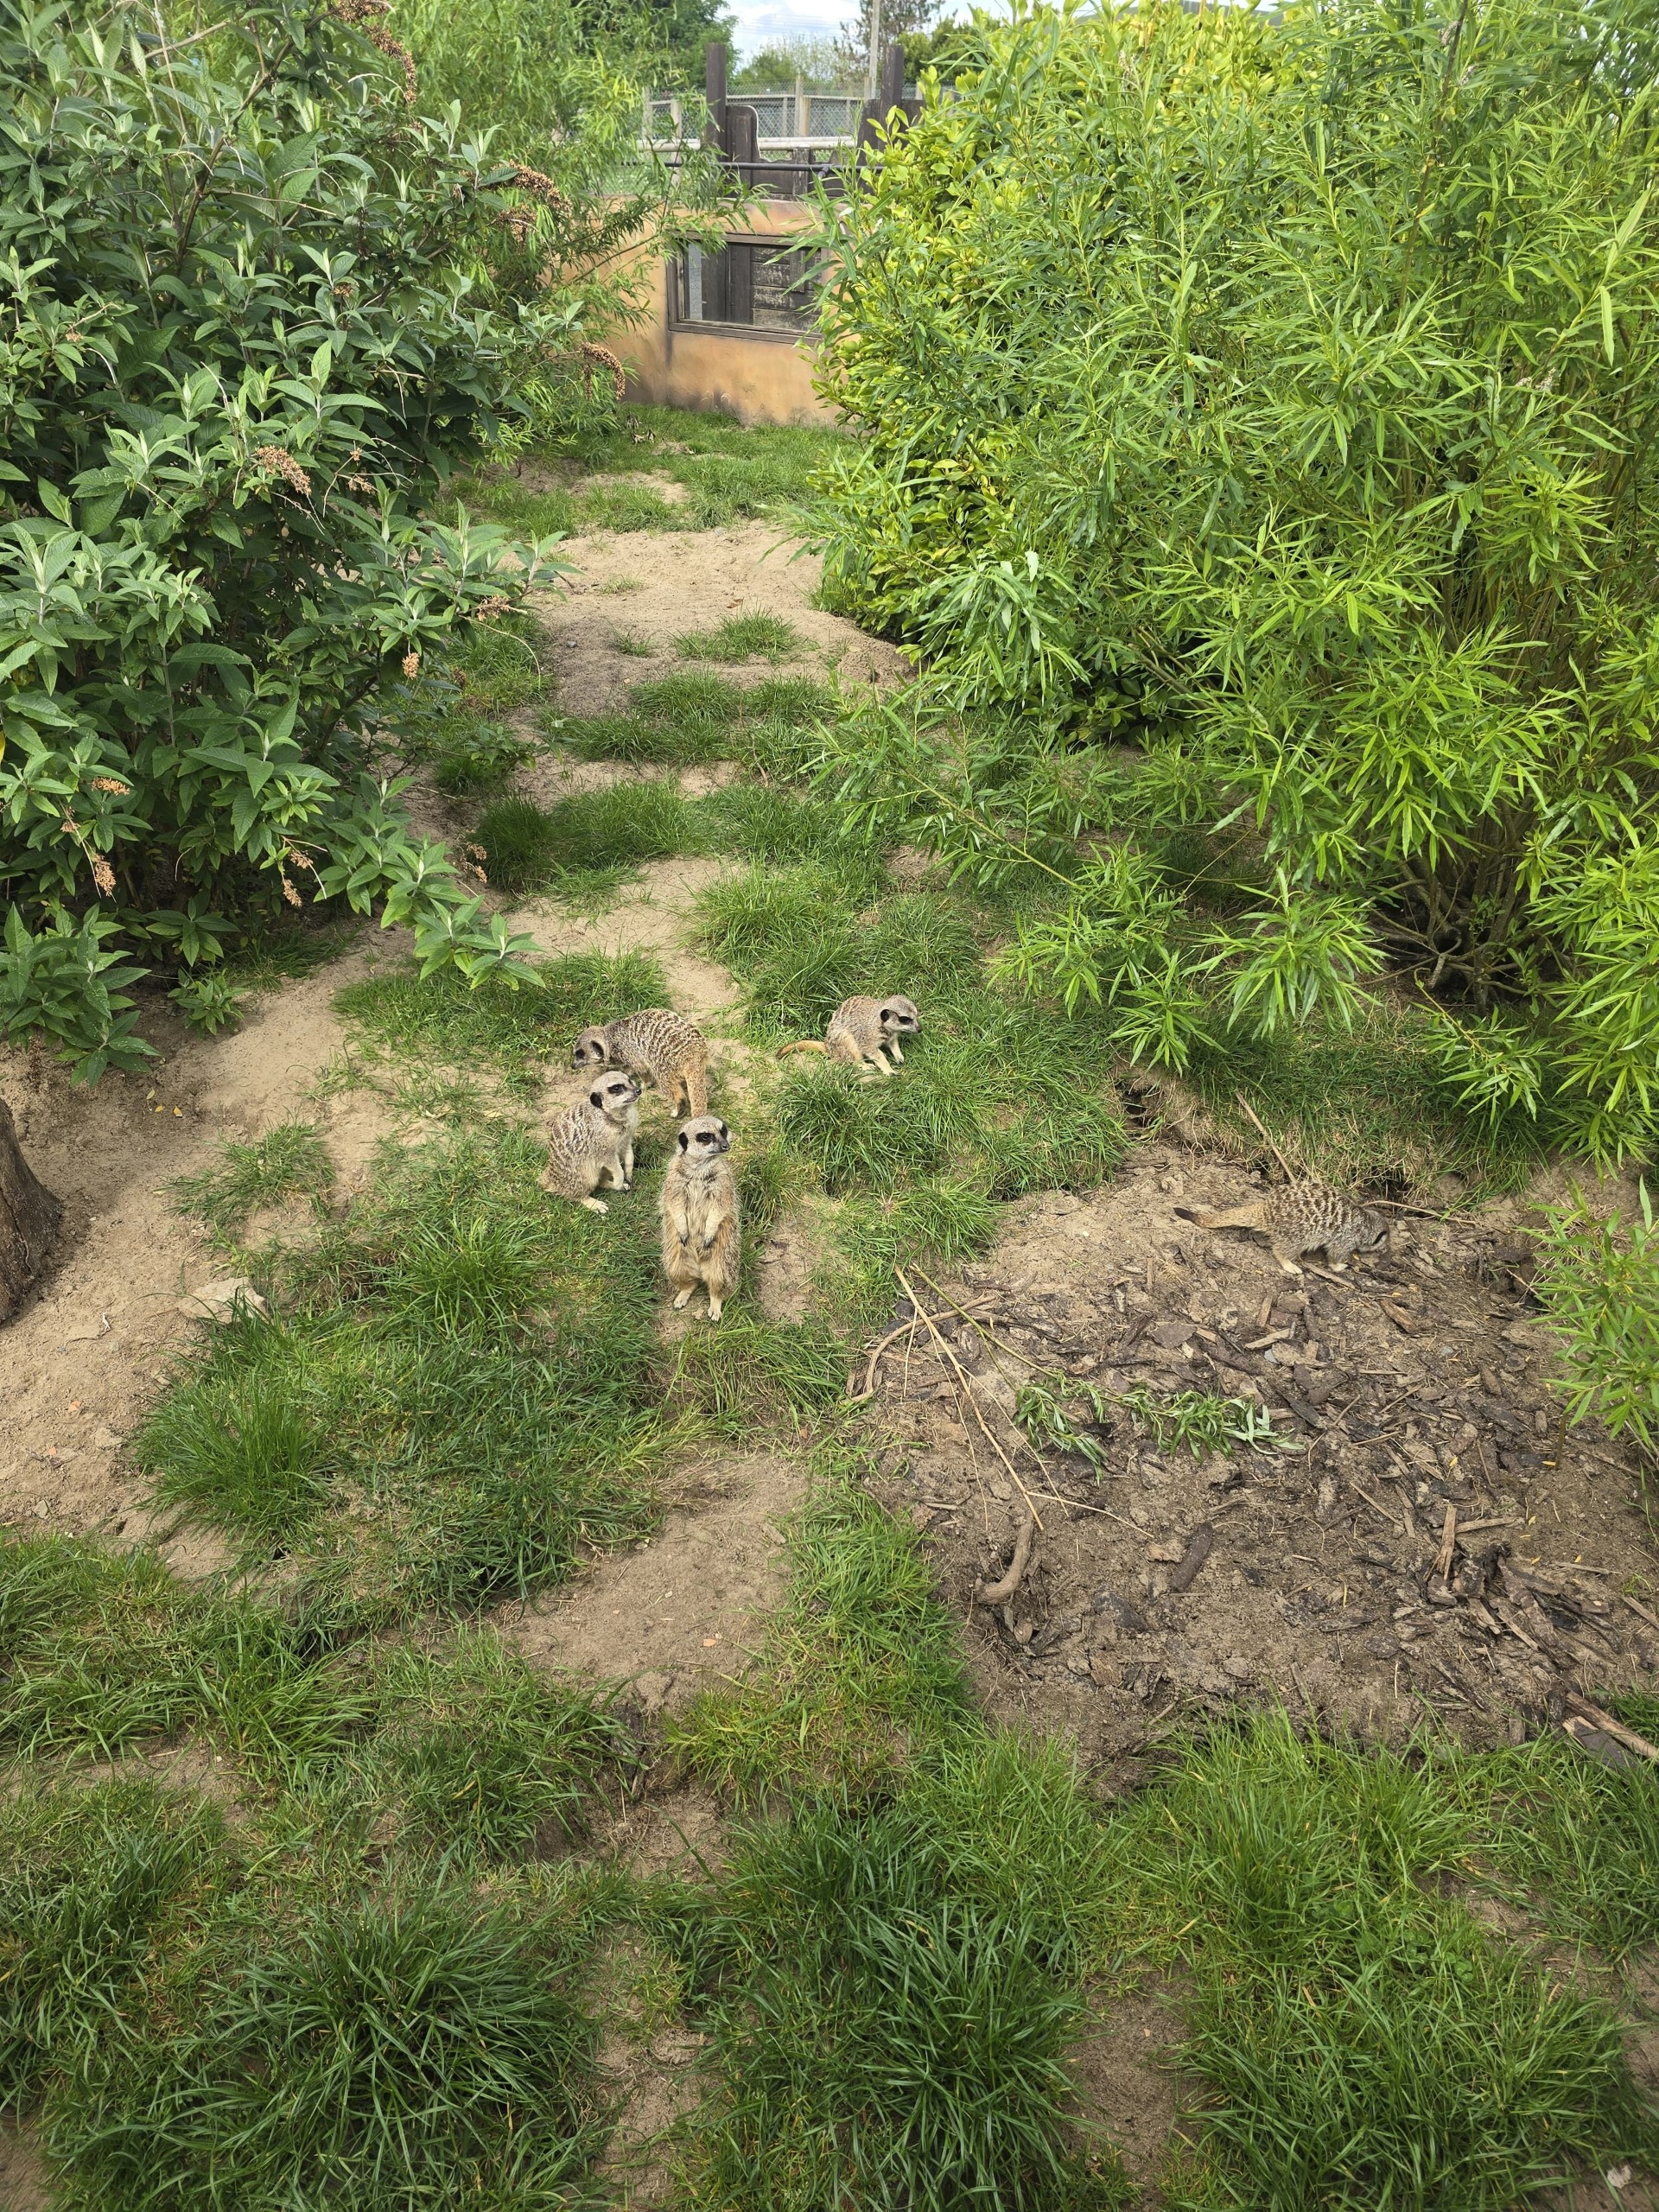
Williams Birthday Trip to Folly Farm
See the adventures William and Barry got up to!
All pictures taken by Barry!

Slide 2
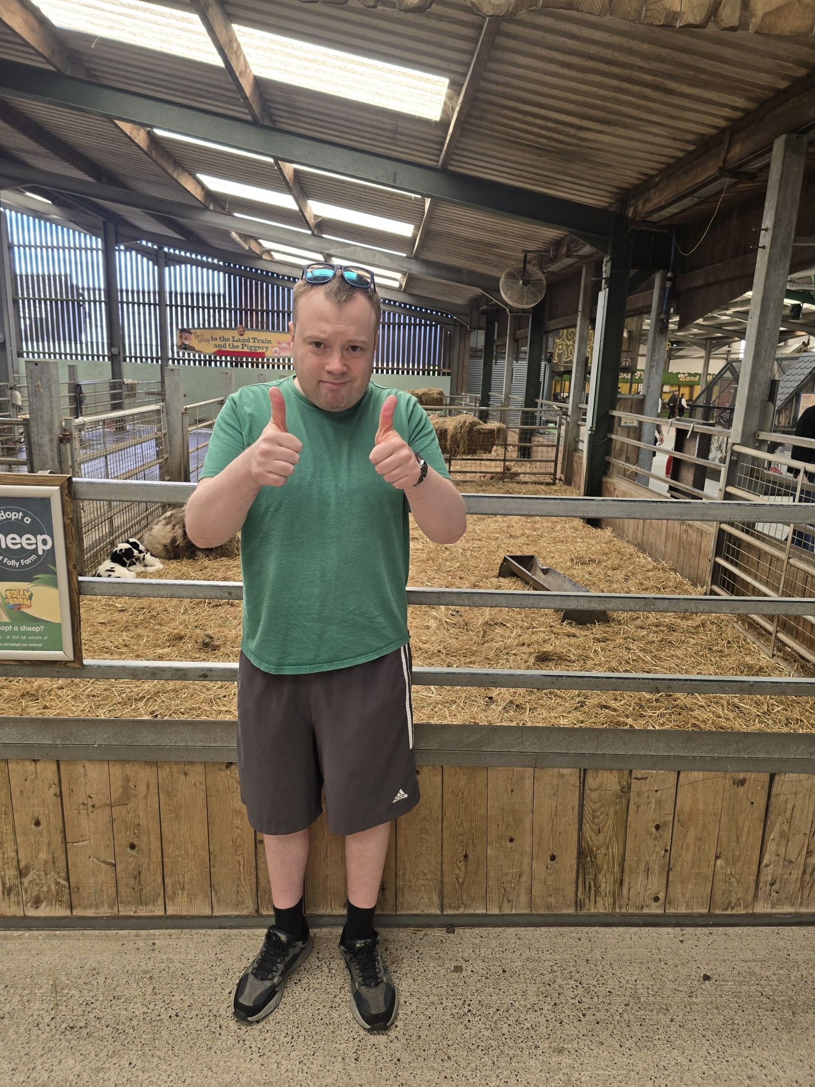
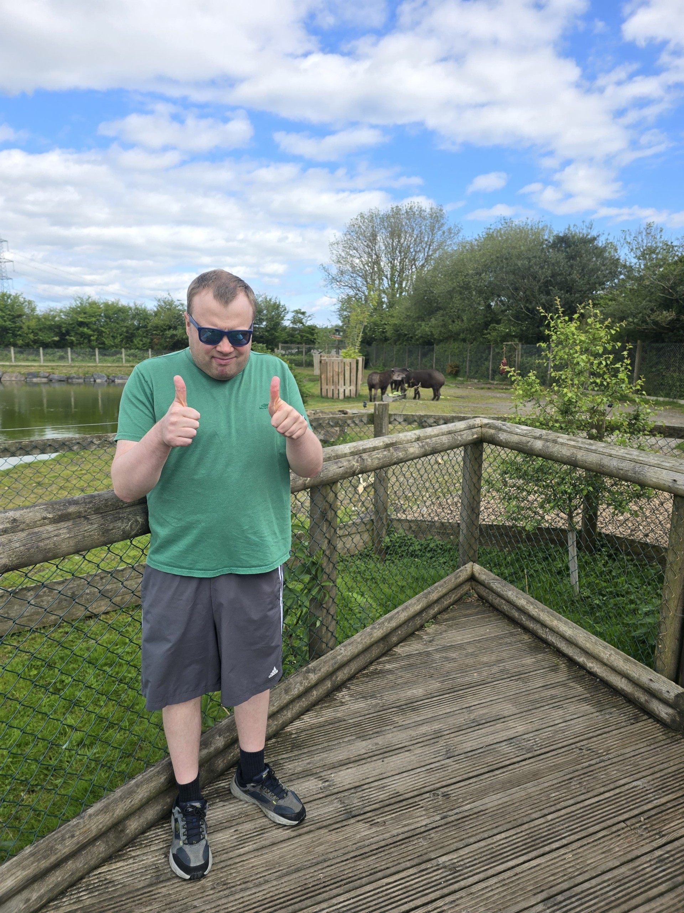
For Williams birthday Gelli Aur Care gifted him a day at Folly Farm! William attended with Barry and saw many special animals like sheep and tapirs!
William enjoyed these two animals but agreed they were a bit stinky!

Slide 3
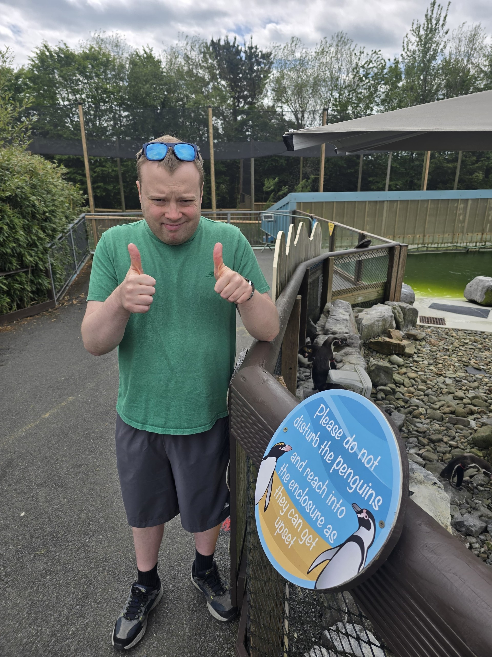
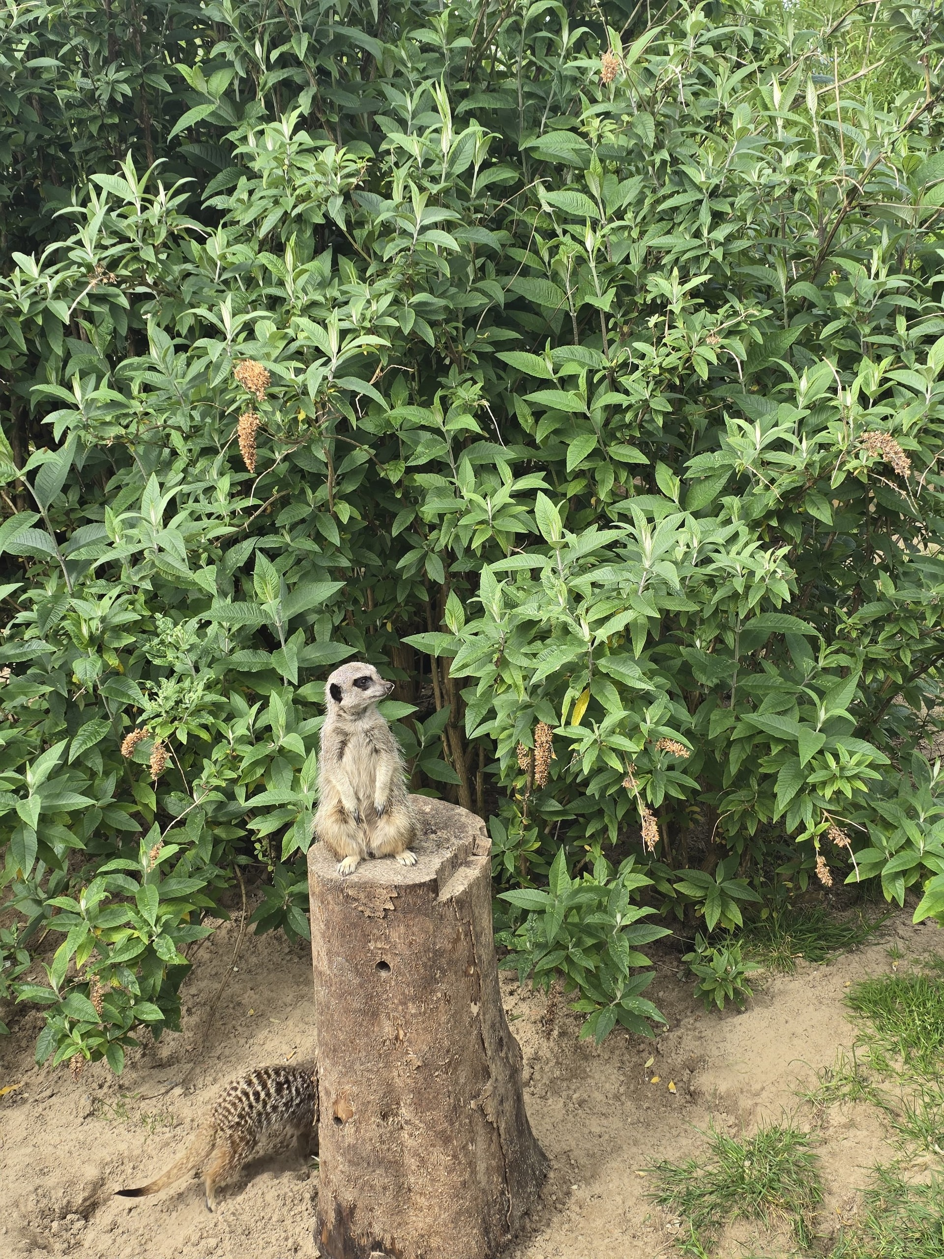
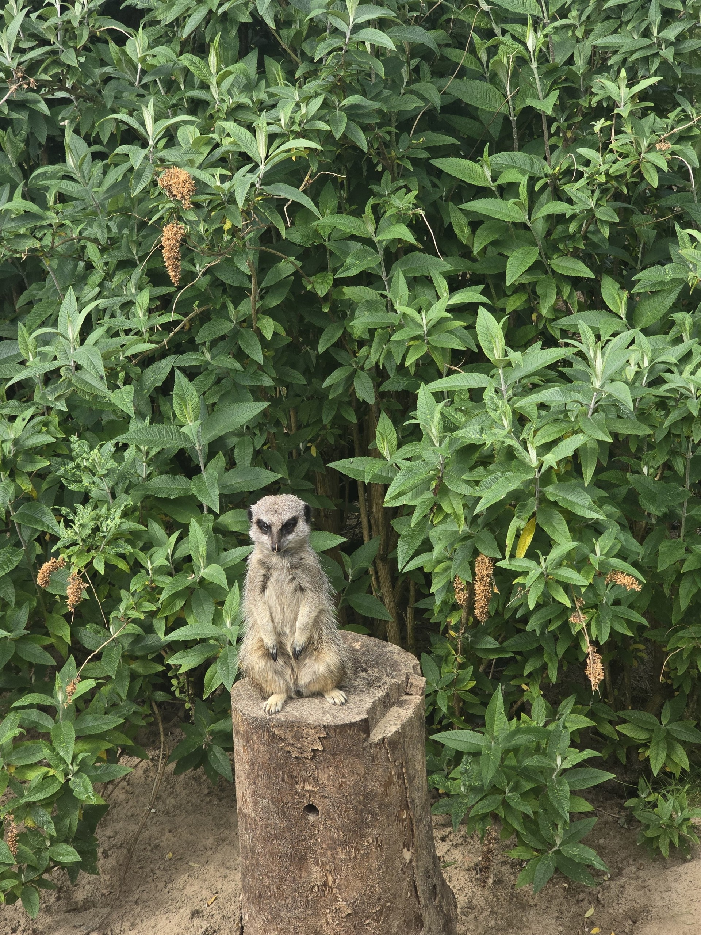
William and Barry visited the penguins! They found out that a penguin called Mr Whippy had been naughty with the zookeeper!
William also visited the meerkat section and enjoyed looking at their different poses!

Slide 4
At Gelli Aur Care we celebrate every Residents birthday and cater their celebration to their needs and preferences.
We listen closely and have conversations with the Residents to get them valuable gifts and experiences.
Allowing the Residents to be apart of their birthday planning improves their wellbeing and we support in every way needed. From receiving help to budget for party food, to guidance on how to socialise with others! At Gelli Aur Care we cater for all!
William had a birthday party on site and invited a few other residents to enjoy some food and birthday decorations.
A big thank you to Tony and Barry for making this day special for William!

