Slide 1

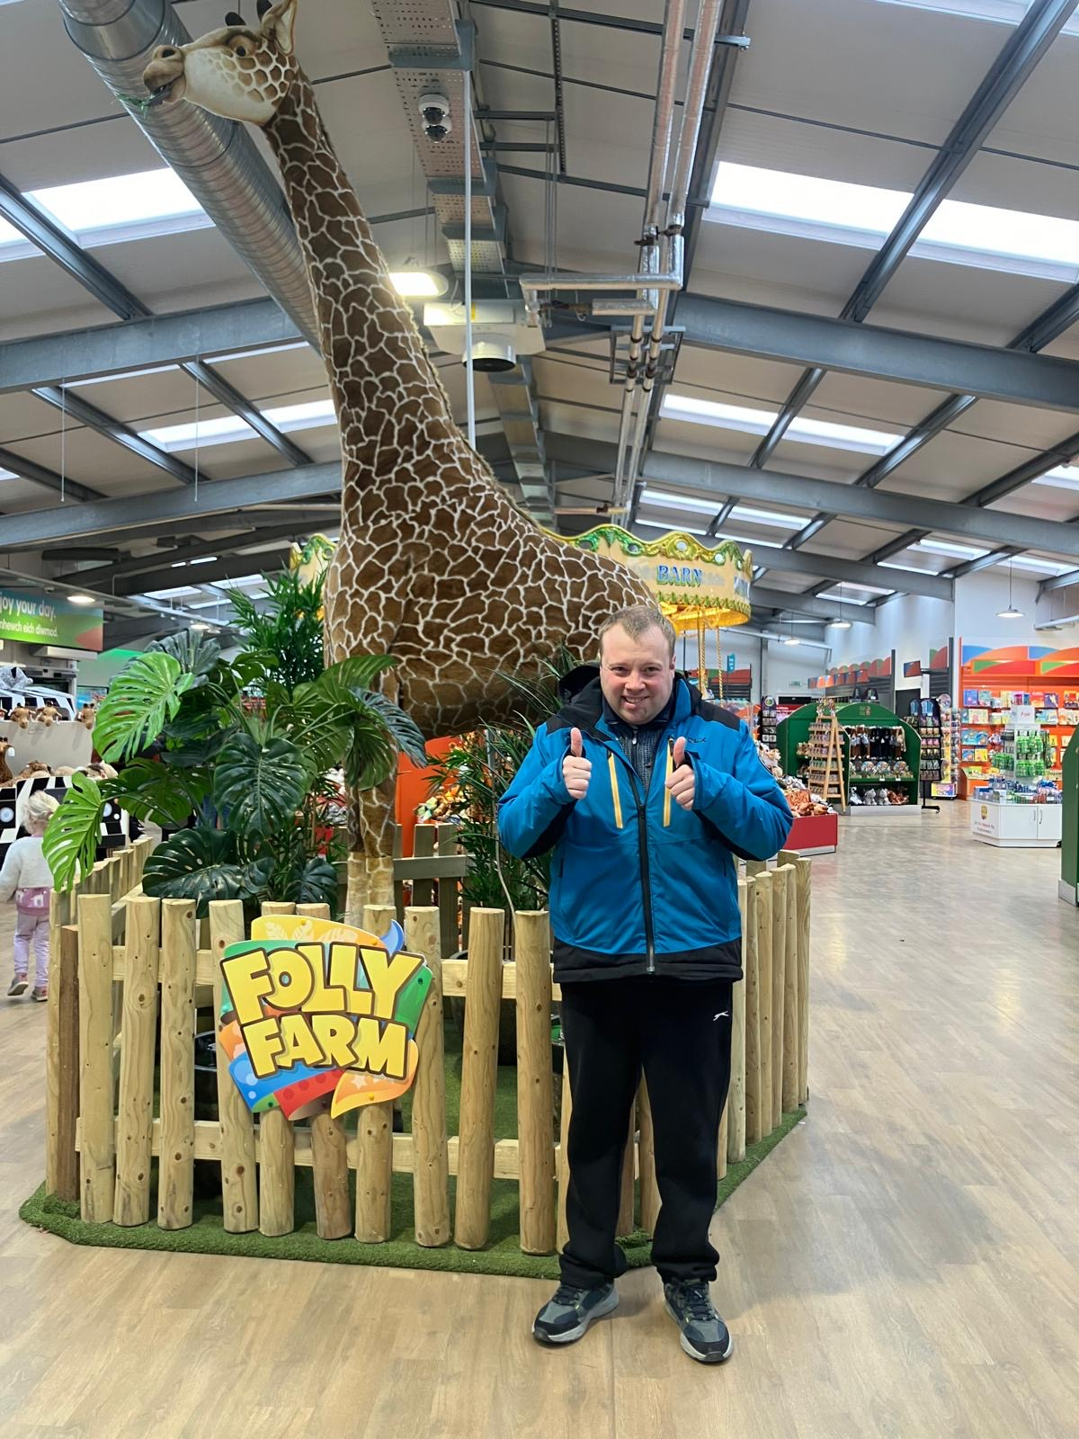
Folly Farm
WM – Folly Farm 1/4/26

Slide 2
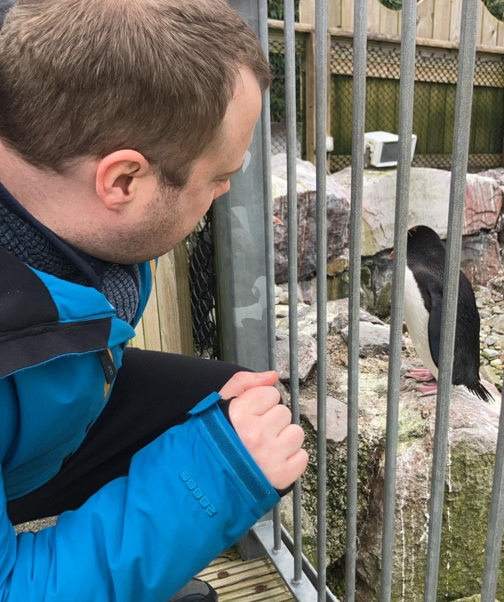
Williams’ adventure :
Today William went to folly farm with Melanie! They saw lots of exotic animals. William enjoyed seeing the giraffes and zebras. Folly farm is a great setting to make exercise fun and enjoyable. Melanie and William walked around Folly Farm, had many photos with the animals, interacted with folly farm staff and had a browse around the gift shop.

Slide 3

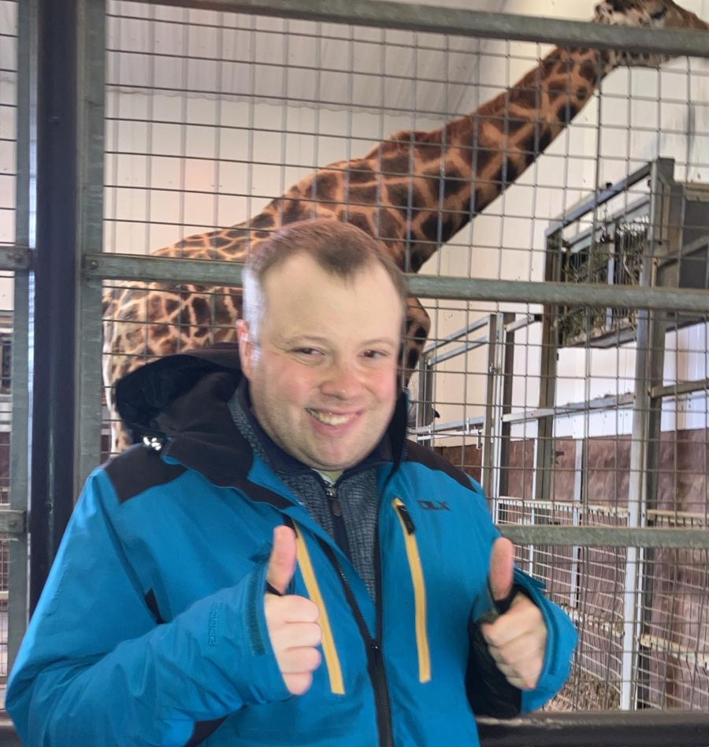
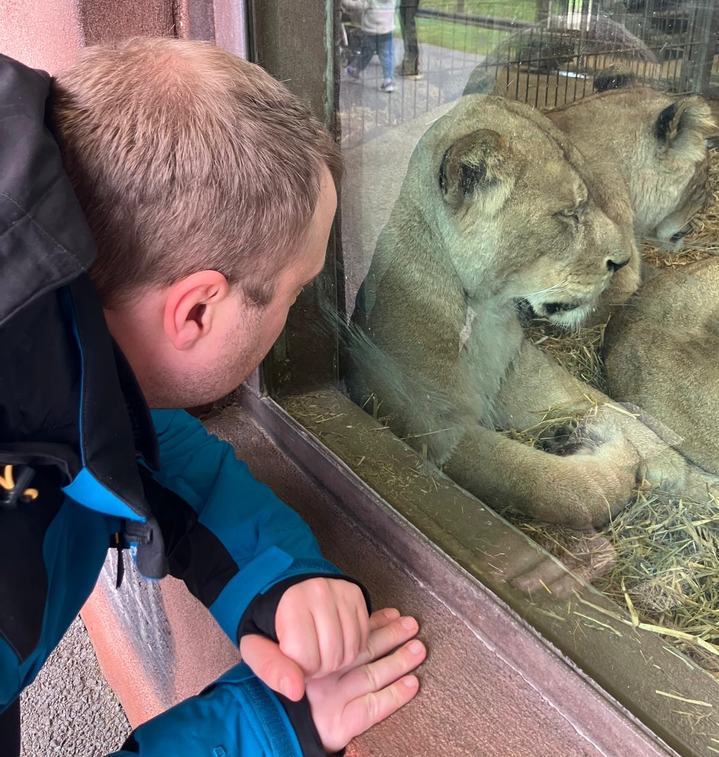
GRRRR!!

Slide 4
At Gelli aur care we do our best to ensure each resident plan their days out with staff beforehand to allow for reduced anxiety and more enjoyment.
William had great pleasure in talking to Chloe about going to folly farm and planned this trip with Barry.
Melanie supported William at folly farm and made sure William had the best time.

