Slide 1
kJ The Builder
8/4/26

Slide 2
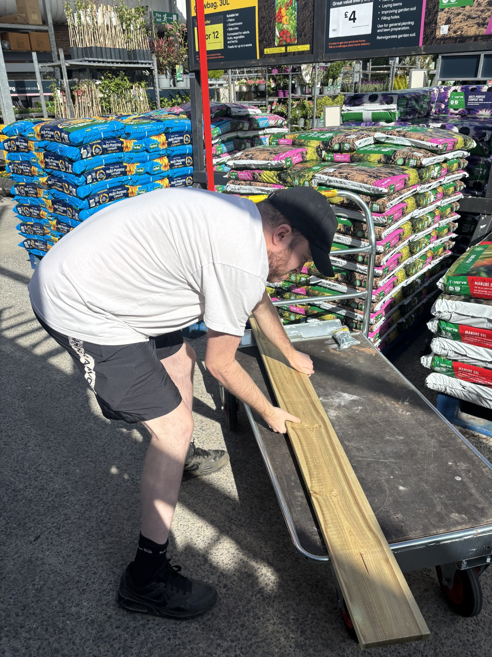
KJ The Builder
On 4/8/26 Kieran had a great idea to continue adapting his garden. He decided to get the equipment required to finish builder his new planter.
Kieran spoke to Chloe and decided it would be best to go to B&Q Carmarthen to get some timber, screws and compost.
After a nice breakfast Chloe and Kieran set out on the adventure to buy building equipment. Of course we stopped beforehand for a Pepsi Max.

Slide 3
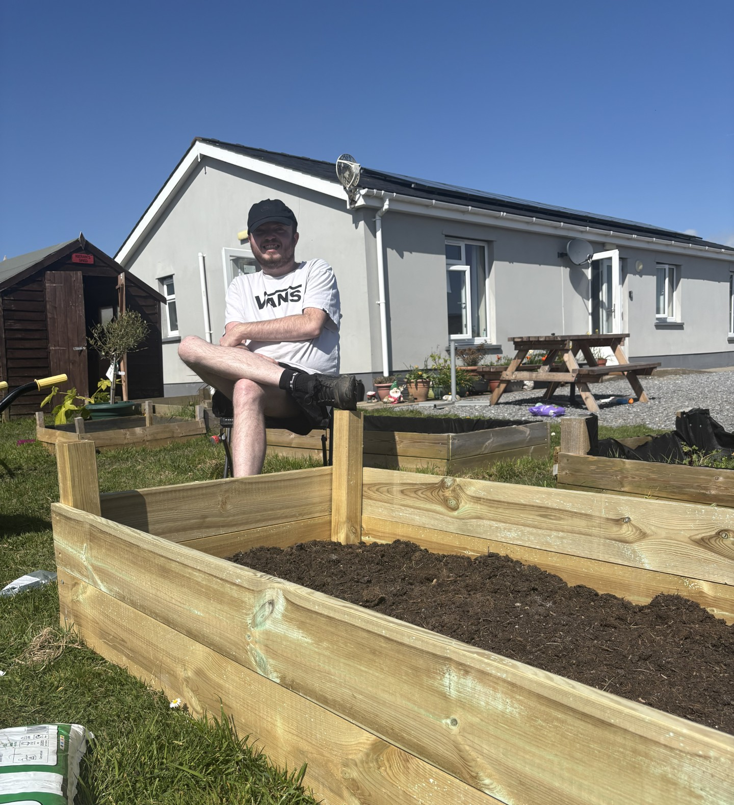
The Building!
The building was the best part!
Once back to Gelli Aur Care, Kieran and Chloe had some lunch and set off on their mission to build a planter!
Kieran got all the equipment required out, Chloe assisted Kieran drilling in the screws and cutting the timber with the saw. Great teamwork!
A nice break was needed to admire their work in the Welsh sunshine!

Slide 4
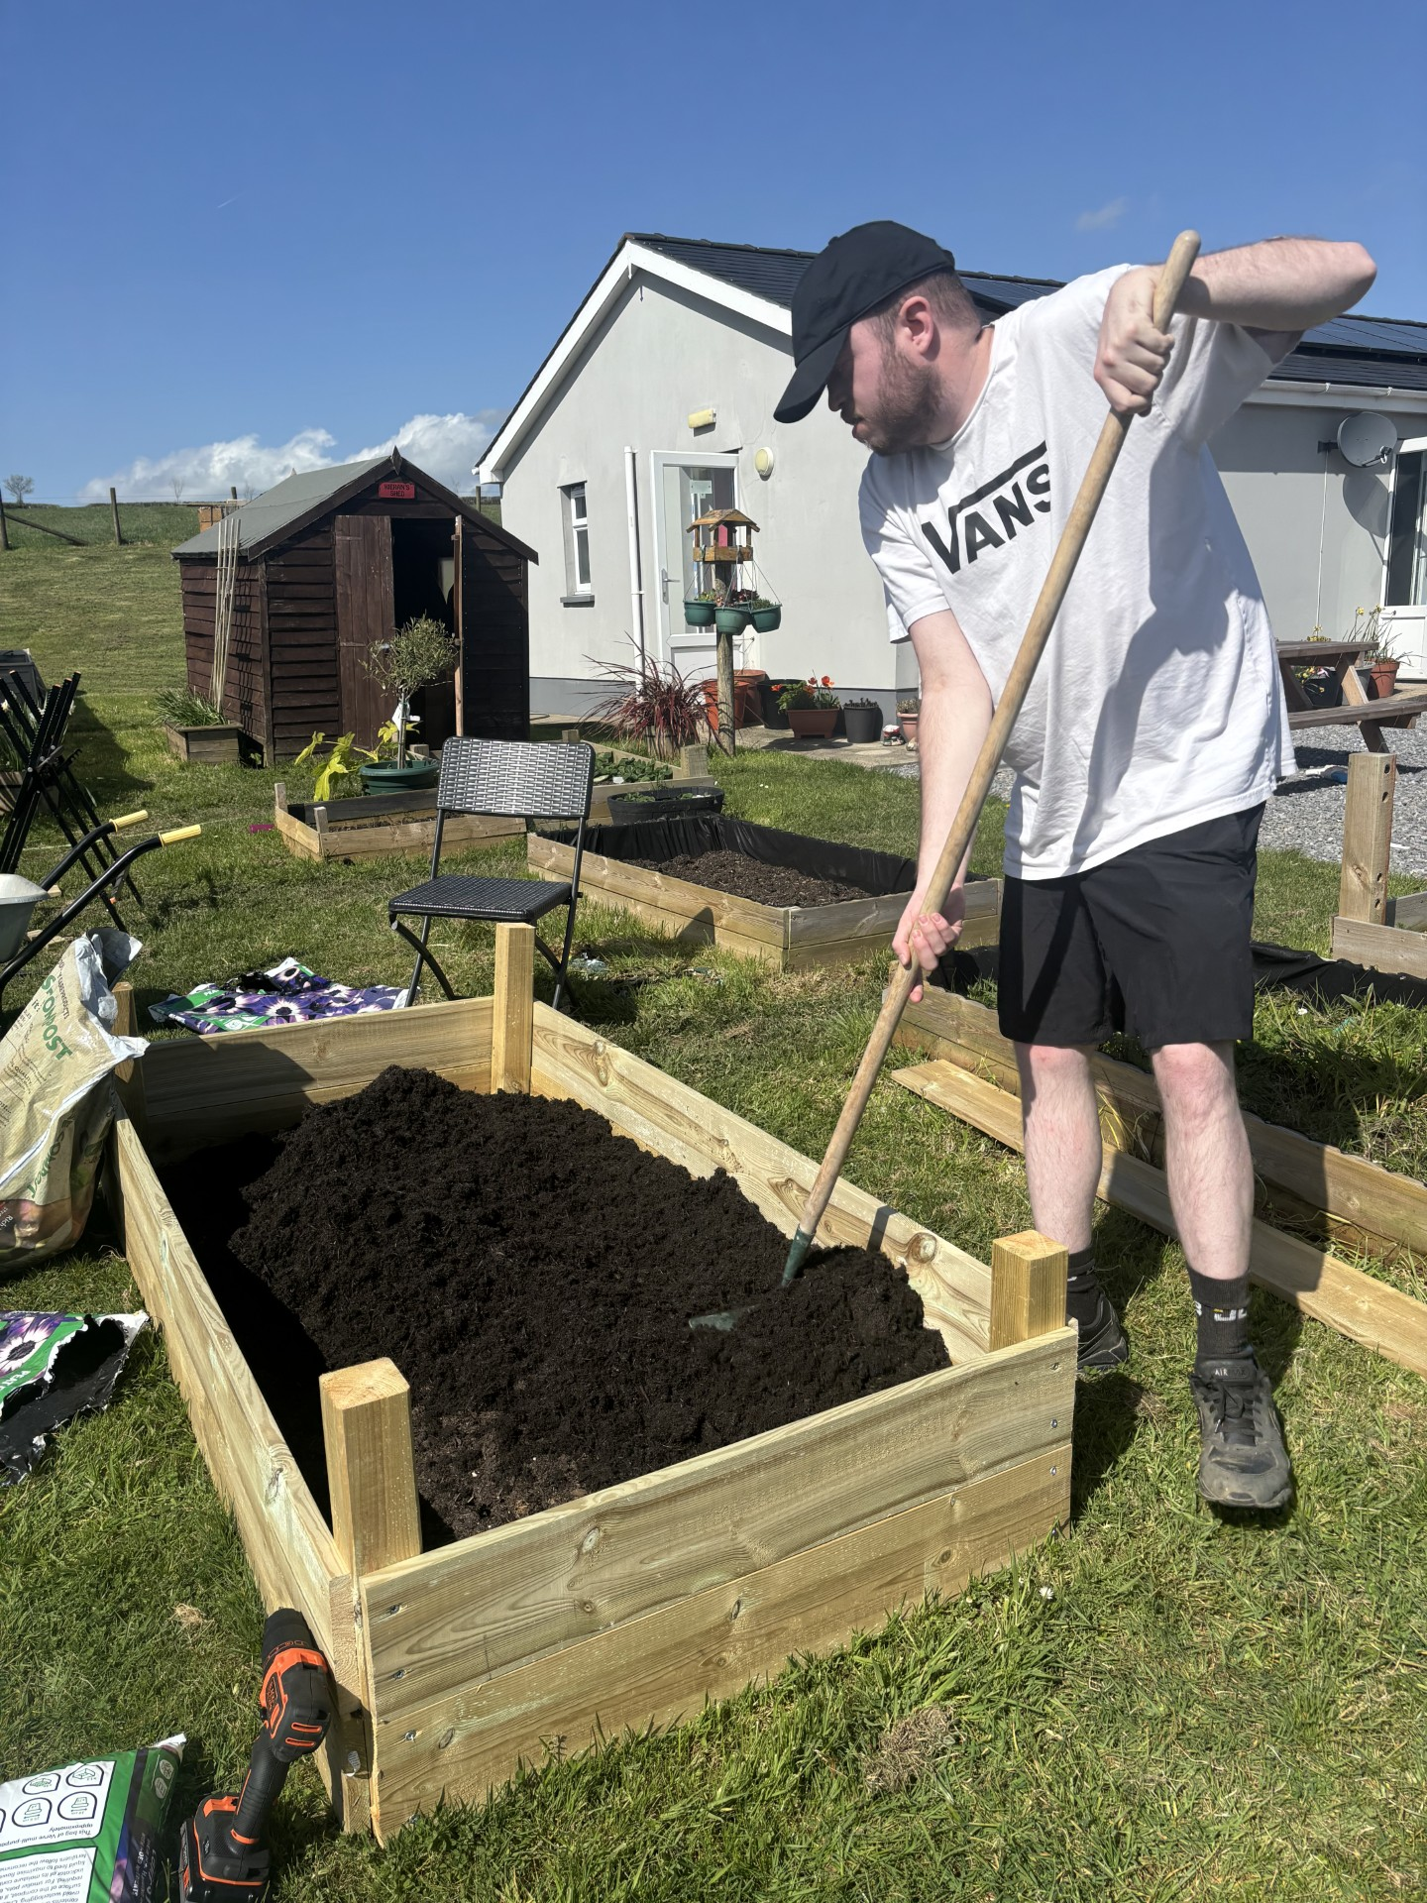
Compost
One last job to complete! The compost…
After a well deserve break, Chloe and Kieran opened three bags of compost and tipped them into the ,new, planter together.
Kieran took liberty in raking the compost to ensure an evenly spread.
Whilst admiring their work Kieran and Chloe produced another idea to develop Keiran's garden!
Stay tuned for more building….

Slide 5
The Importance
At Gelli Aur Care Ltd, any residents’ wishes, within reason, are carefully risk assessed, planned and performed. An activity like building is a great way for residents to show their independence, learn more skills and do this in a safe environment.
Support staff at Gelli Aur Care take into consideration all type of support such as emotional, physical, self-esteem, tangible, developmental and practical support. We ensure a person-centred approach with our Resident’s best interests at mind.
In this case Chloe helped Kieran physically to build the planter, emotionally reassured Kieran that the timber was the correct length and praised Kieran when developing/using his gardening skills.
Well done Chloe & Kieran!!

