Slide 1
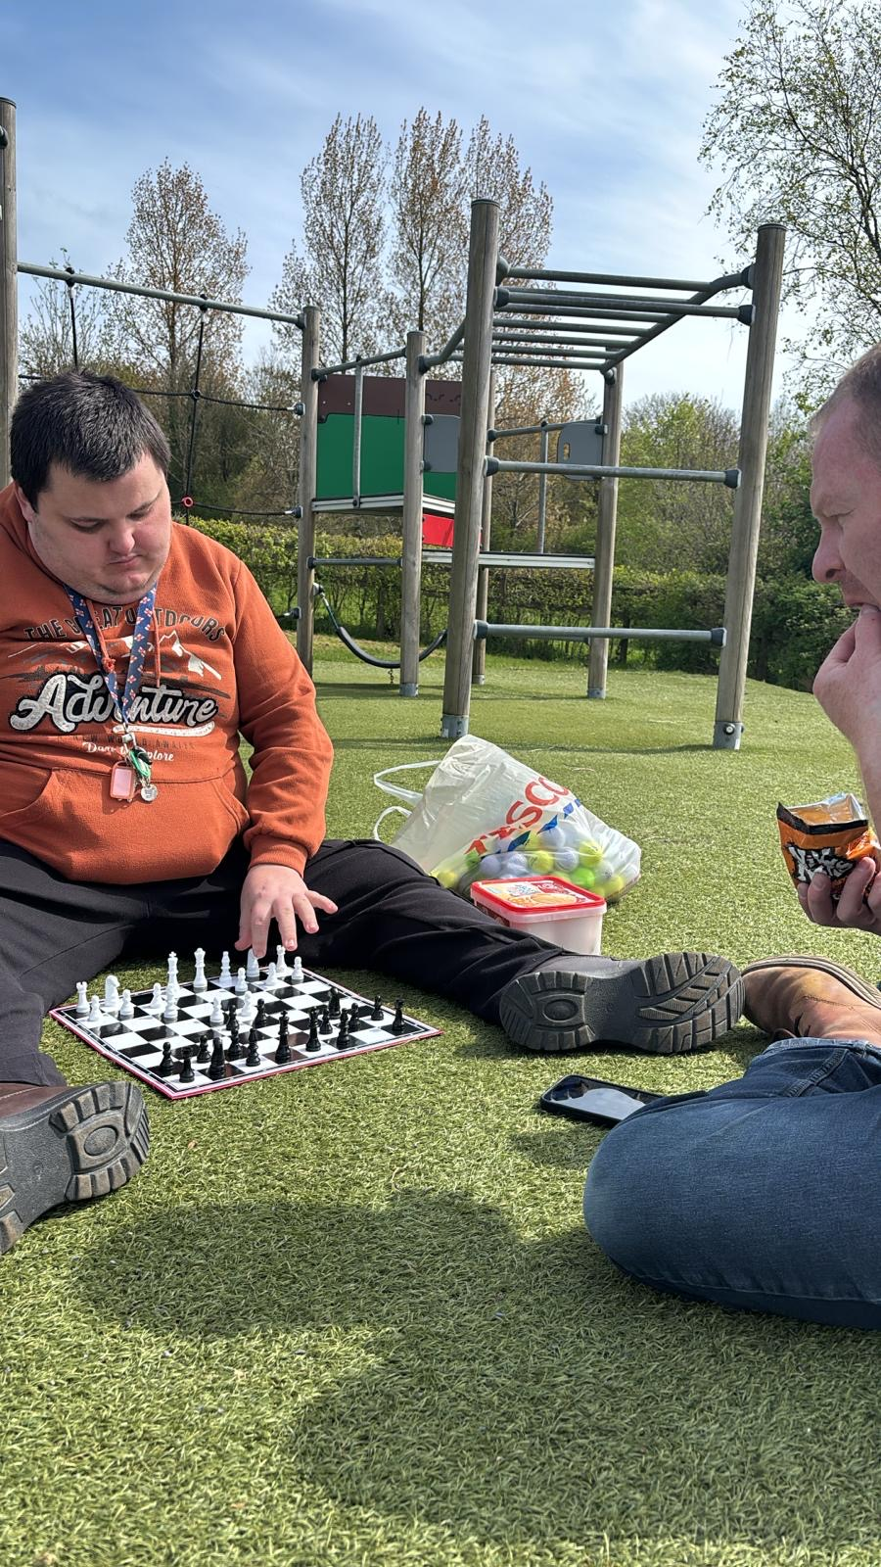
Daniel’s Park Adventure – East Williamson
21/4/26

Slide 2
Chess!
Once arriving to the East Williamson park Daniel got comfortable with Andy and started playing Chess!
Chess is a great co-ordination game and requires great skill and concentration!

Slide 3
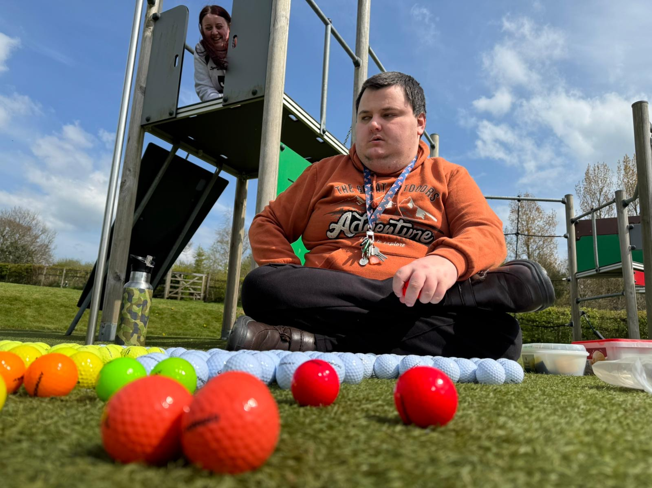
Golf Balls!
Once chess was finished and packed away, Daniel got his bag of golf balls out!
Daniel enjoyed putting his golf balls into groups of colours.
Meanwhile, Molly was being directed by Daniel to use the apparatus surrounding them!
Is that you Molly?

Slide 4
At Gelli Aur we encourage Residents to take part in activities to their request, if they have been risk assessed! Many of our BLOGs so far have consisted in big planned days out, whereas Daniel's calm activity was enjoyed just the same!
A simple trip to the park became a great day out for Andy, Molly and Daniel. This was a safe space for Daniel to organise his golf balls, direct Molly to the apparatus and play chess. All in a calm, accepted environment!
Molly and Andy supported Daniel to get to this location, participated in activities on Daniel's behalf and joined in with Daniel once asked! Trips like this will continue to strengthen Daniel's wellbeing and self- esteem.
Well done to Molly, Andy and Daniel!

