Slide 1
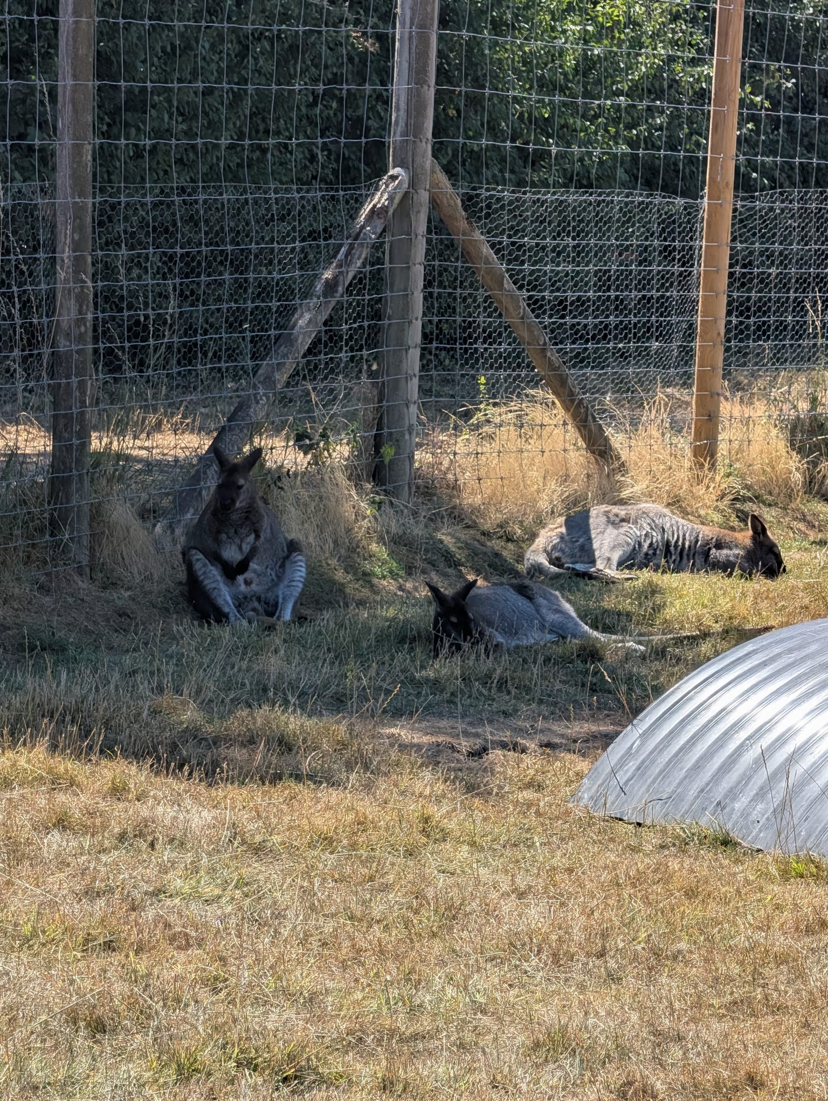
Max Longleat Zoo
10th – 11th August 2026
All images captured by Tony Scheurer

Slide 2
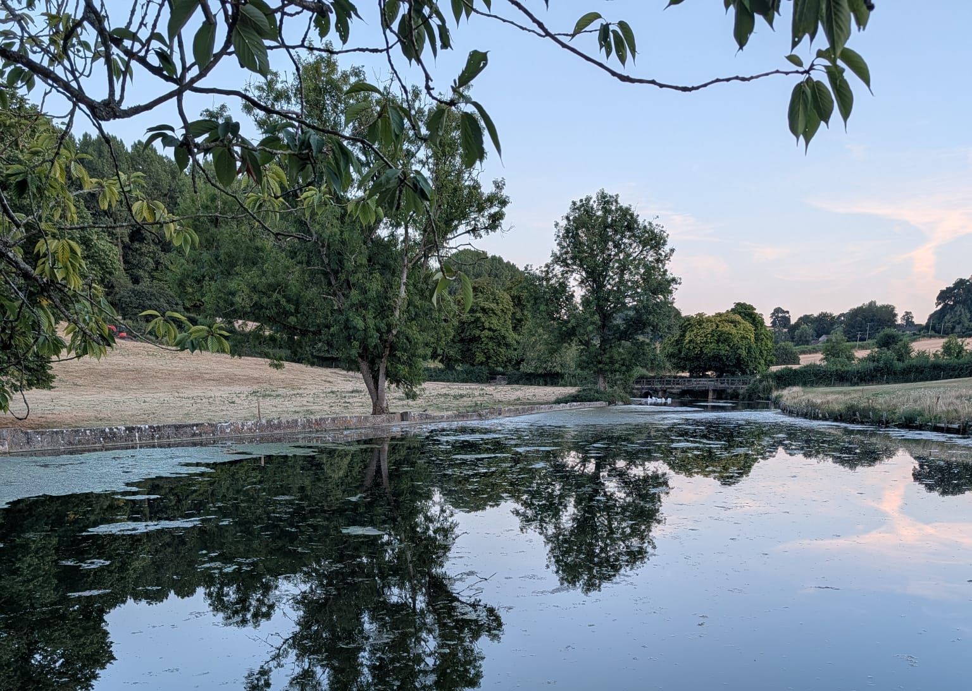
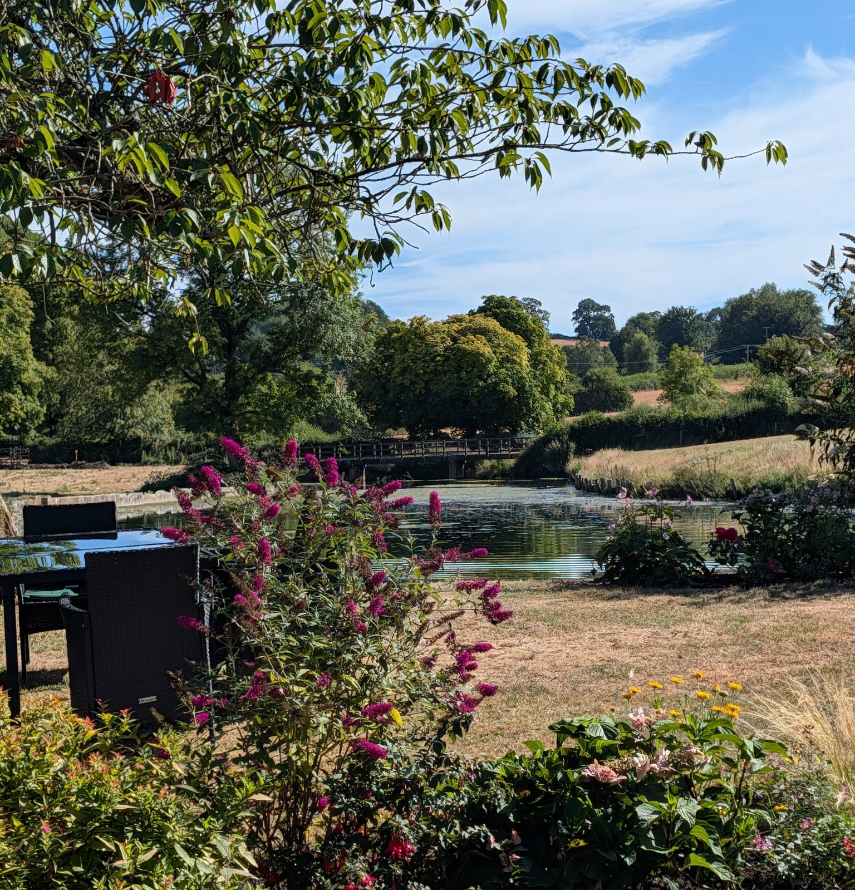
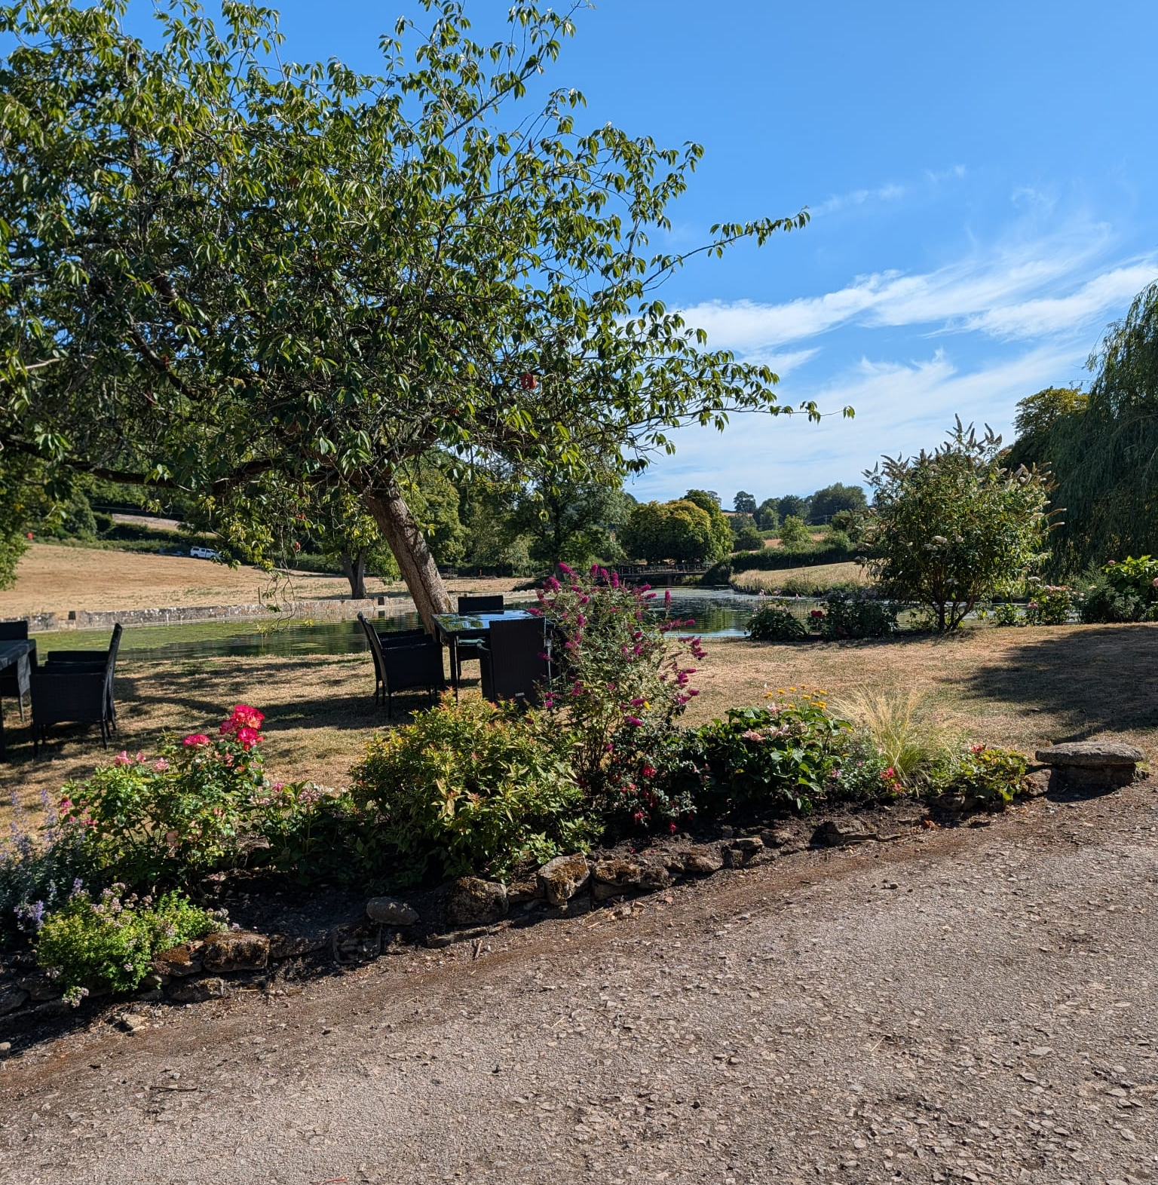
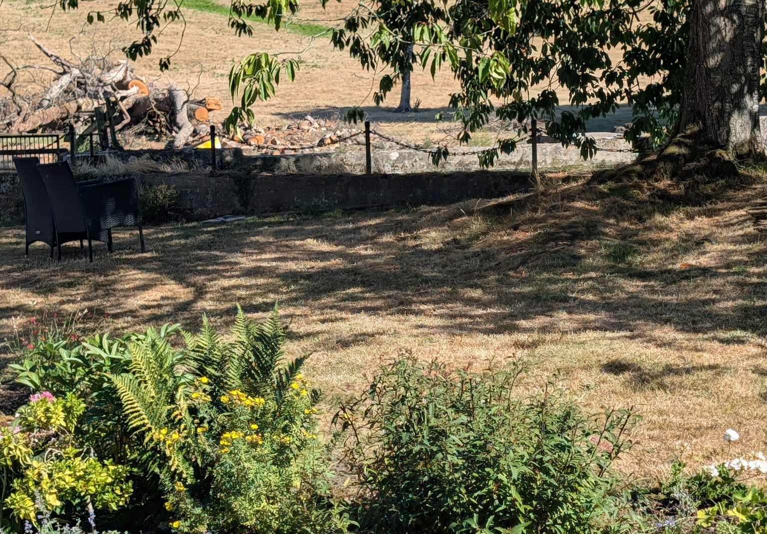
Accommodation
Max and Tony stayed in a beautiful location, very close to Longleat zoo! Max enjoyed his dinner next to a beautiful pond and flower scenery.
This accommodation was calming and allowed Tony and Max to have a break away from the busy environment that Longleat has.

Slide 3
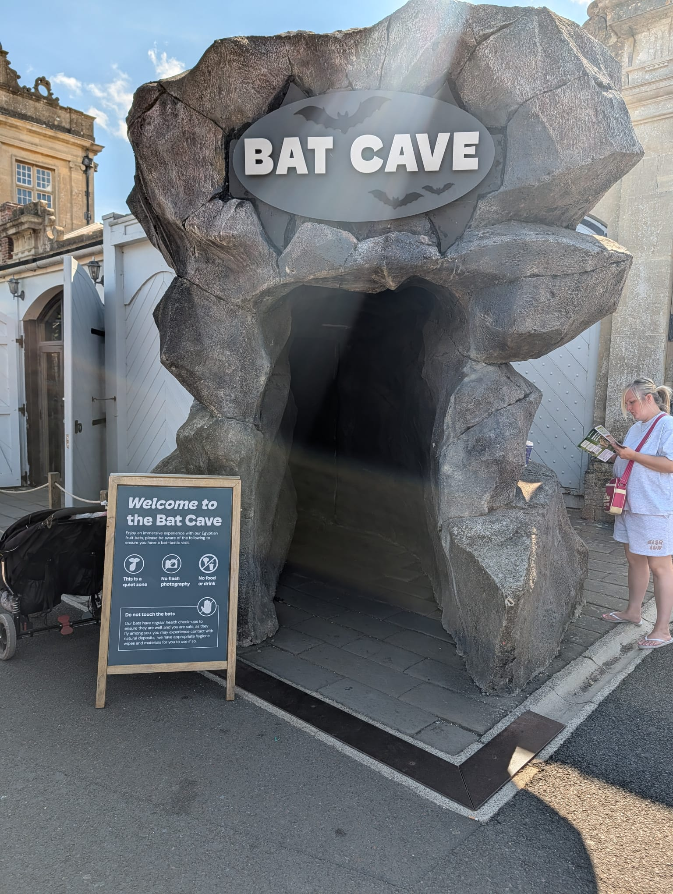
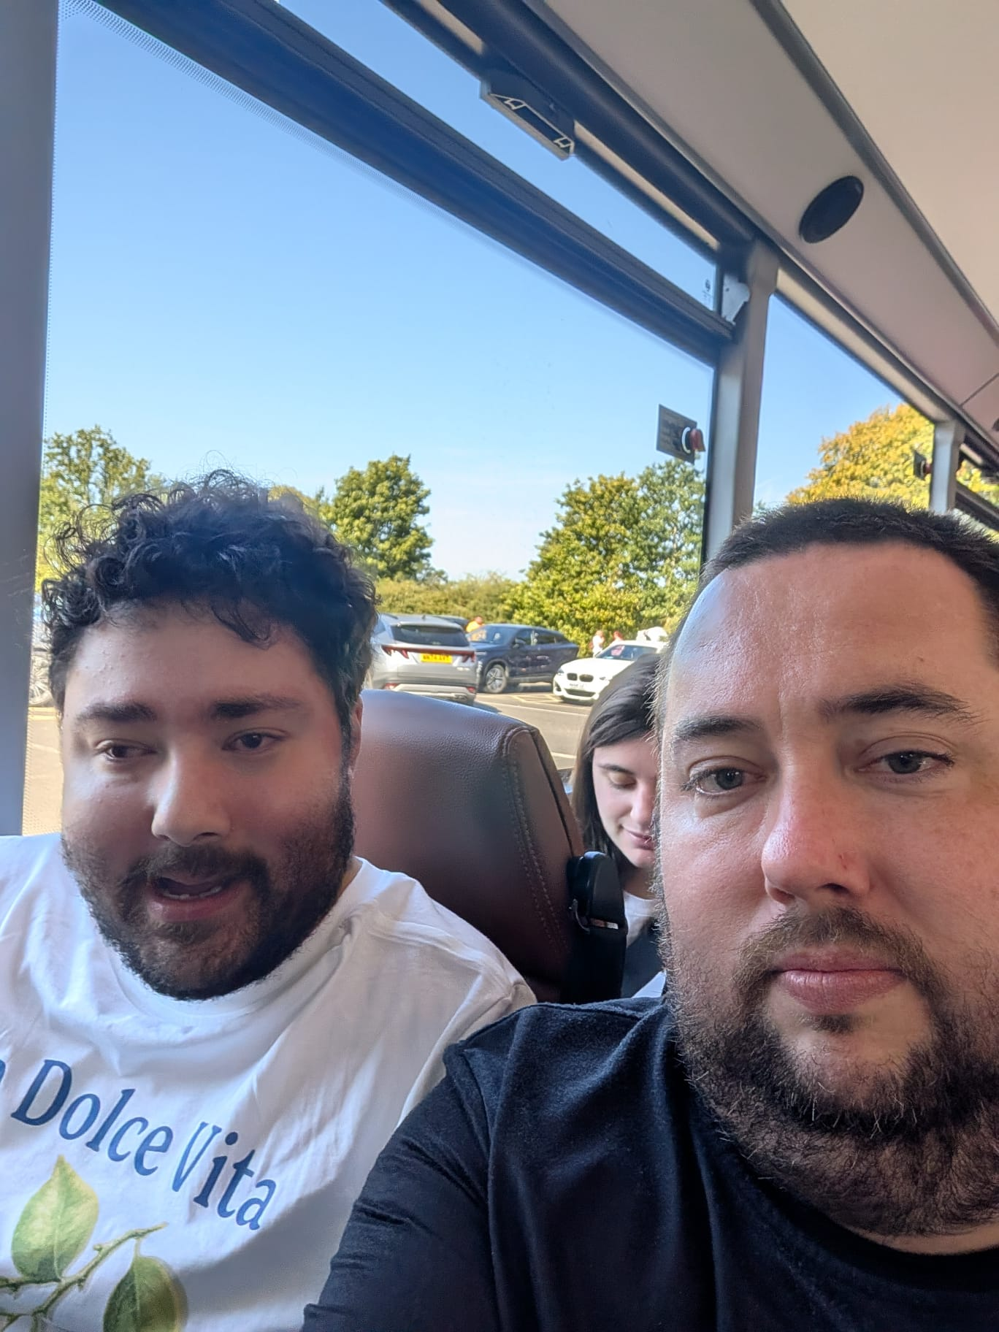
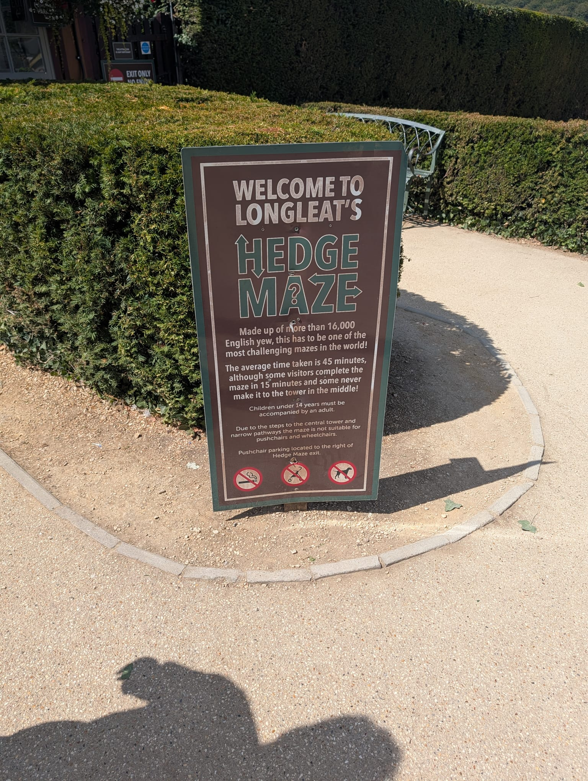
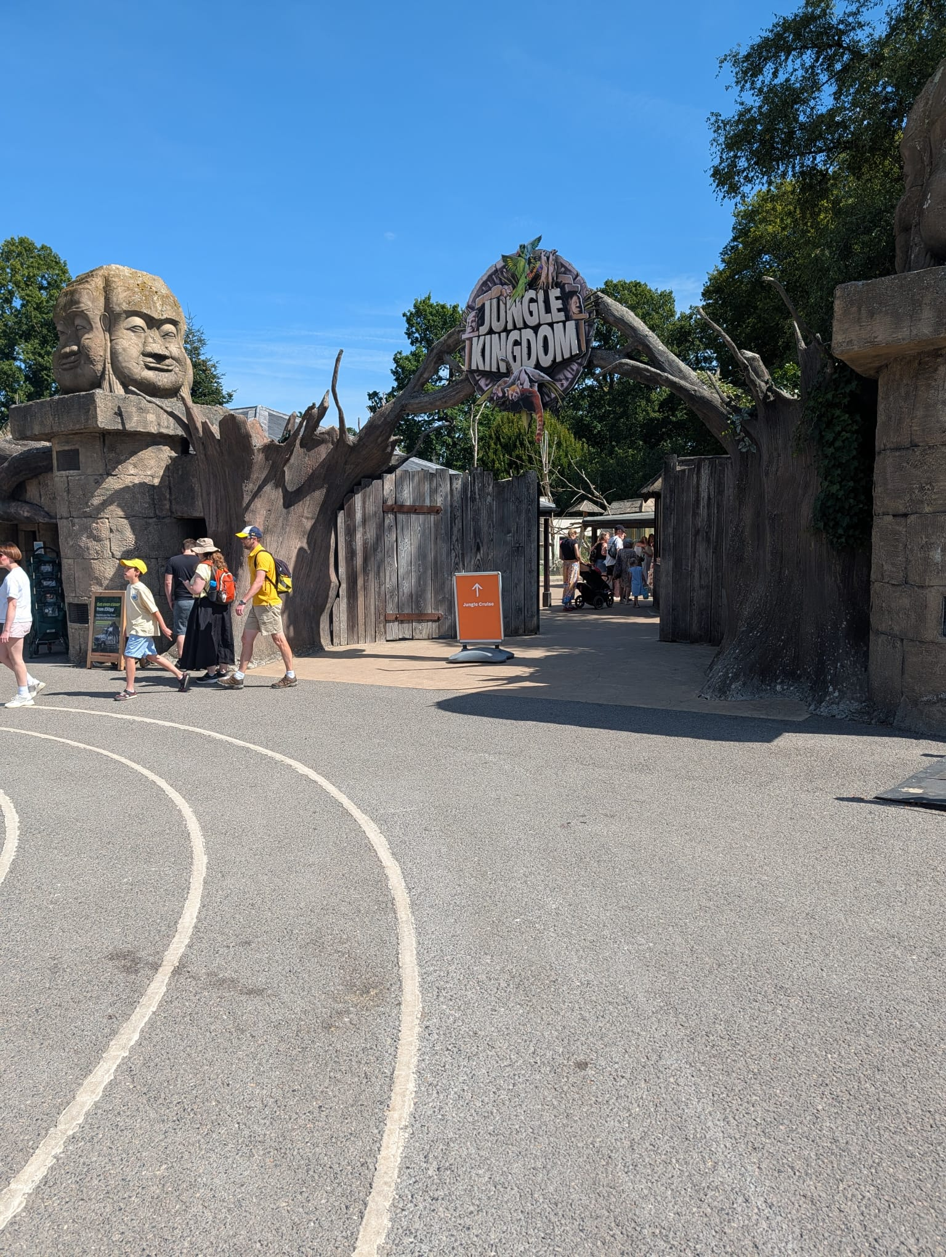
Longleat
Max is very fond of Longleat and has visited before with Andy!
Max was looking forward to the Longleat Maze and exploring the park more. Luckily, the sun was shinning, and Max took part in many activities!
Max enjoyed the Maze, Safari bus tour and Hour tour.

Slide 4
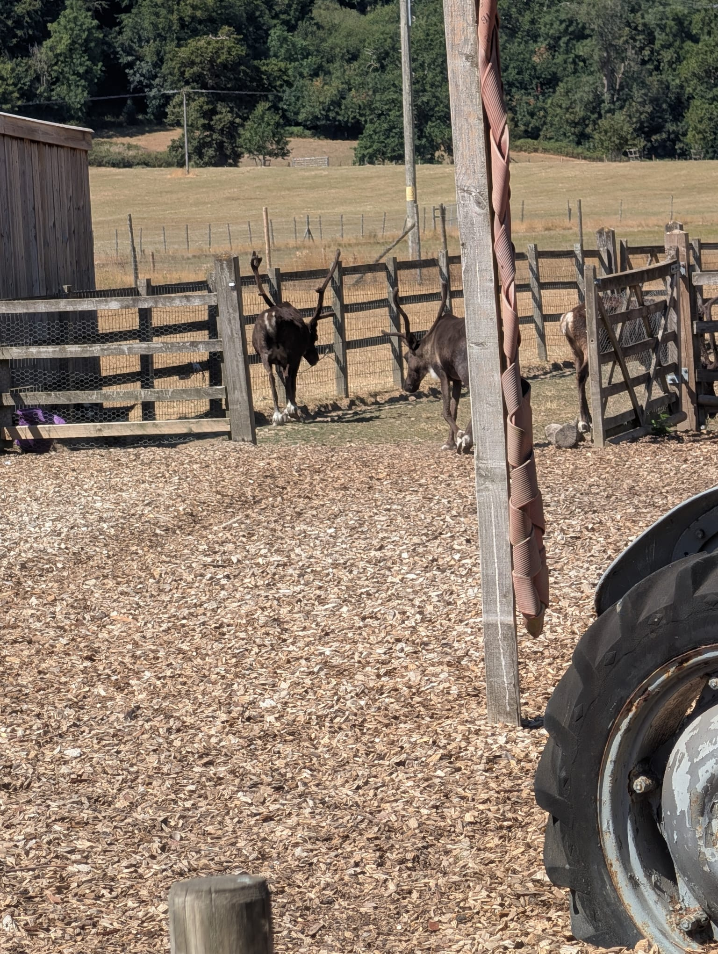
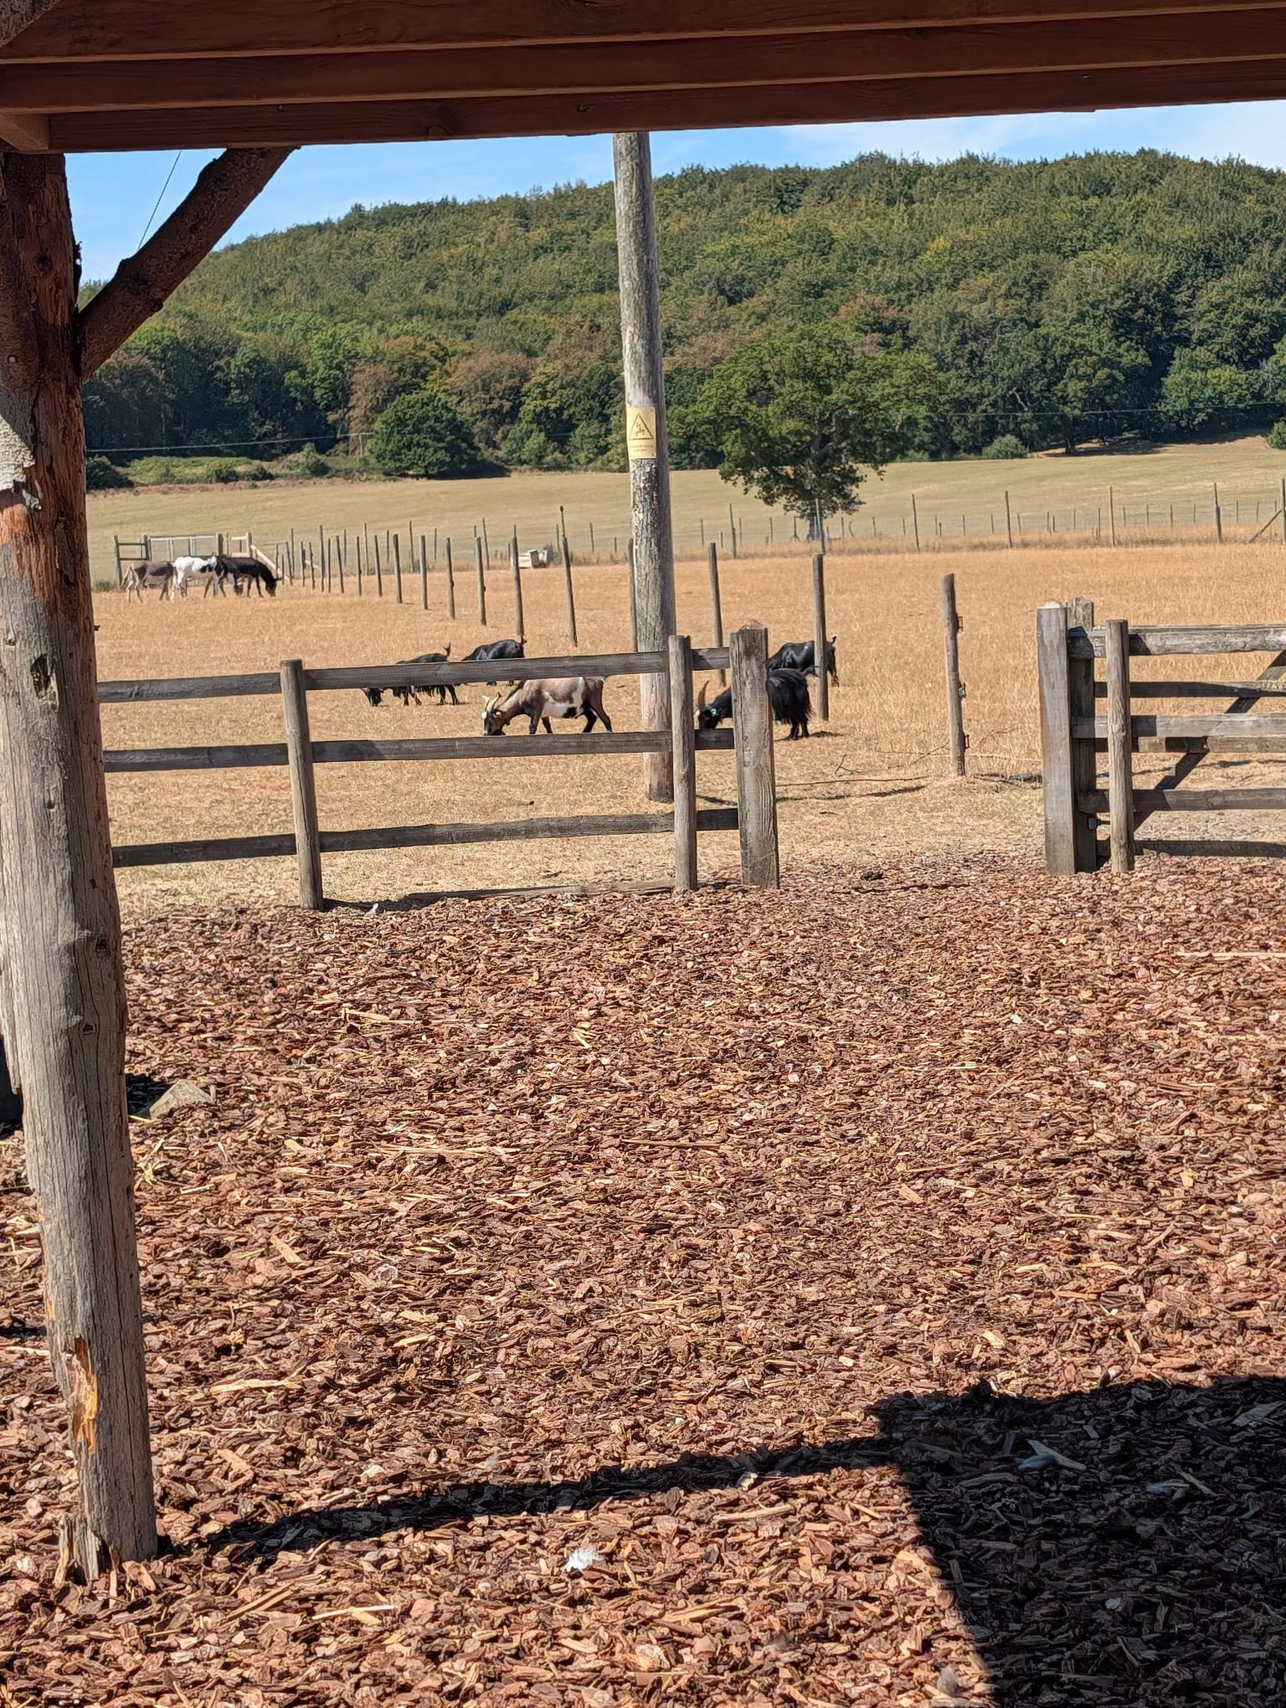
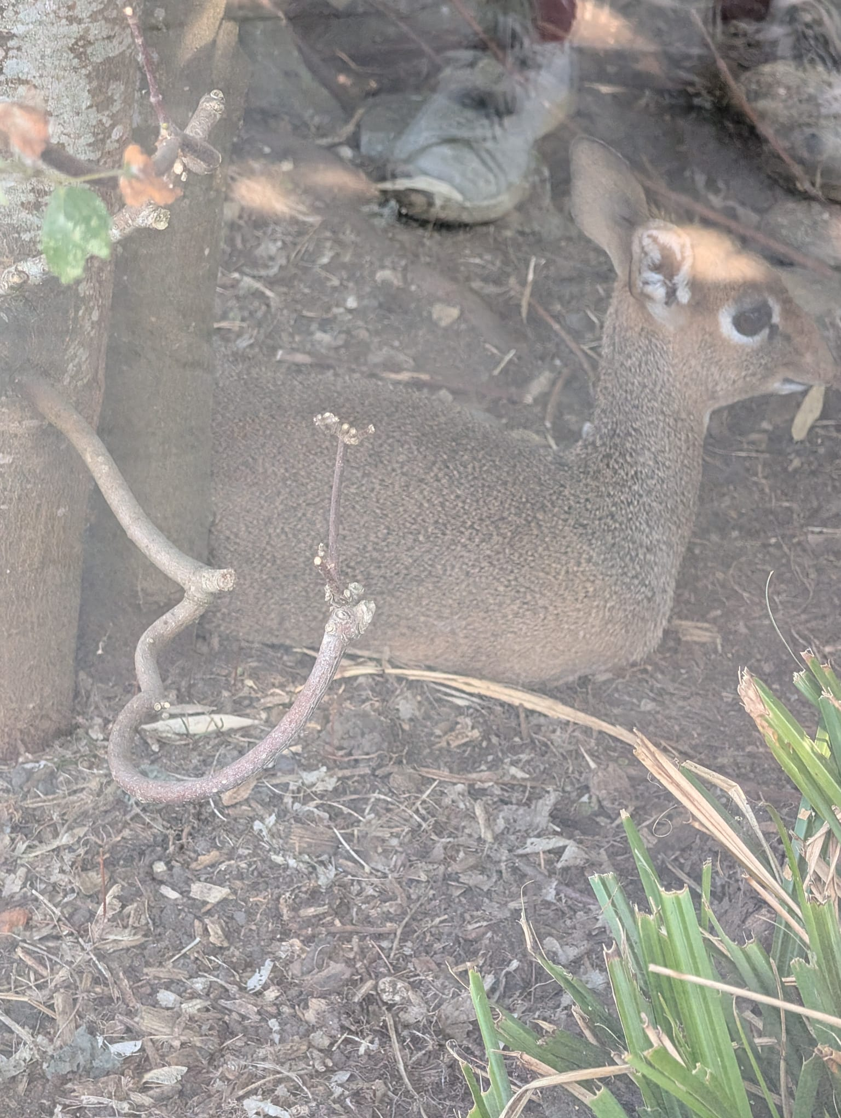
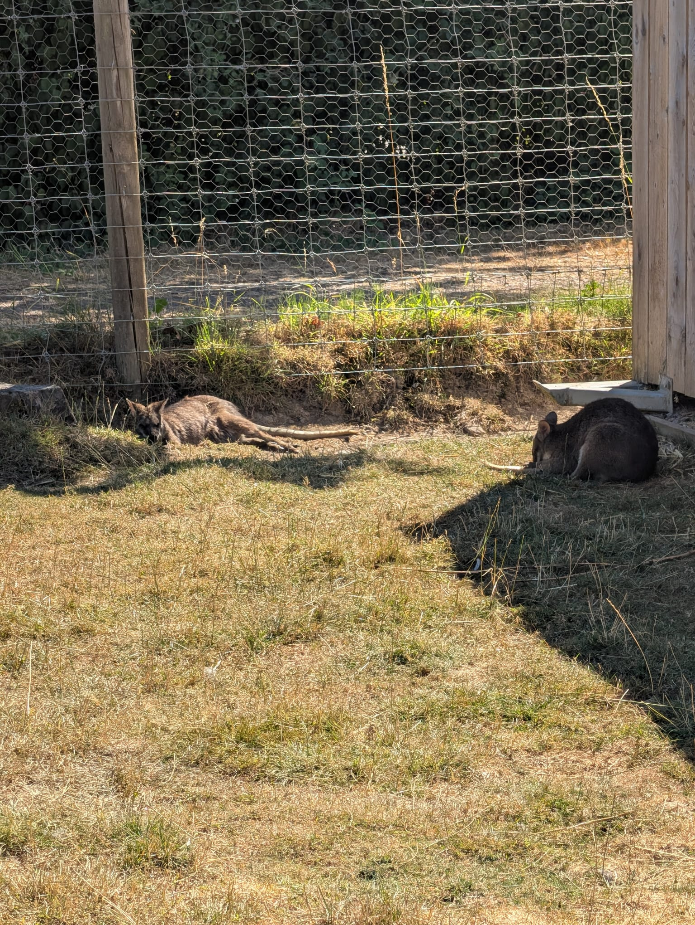
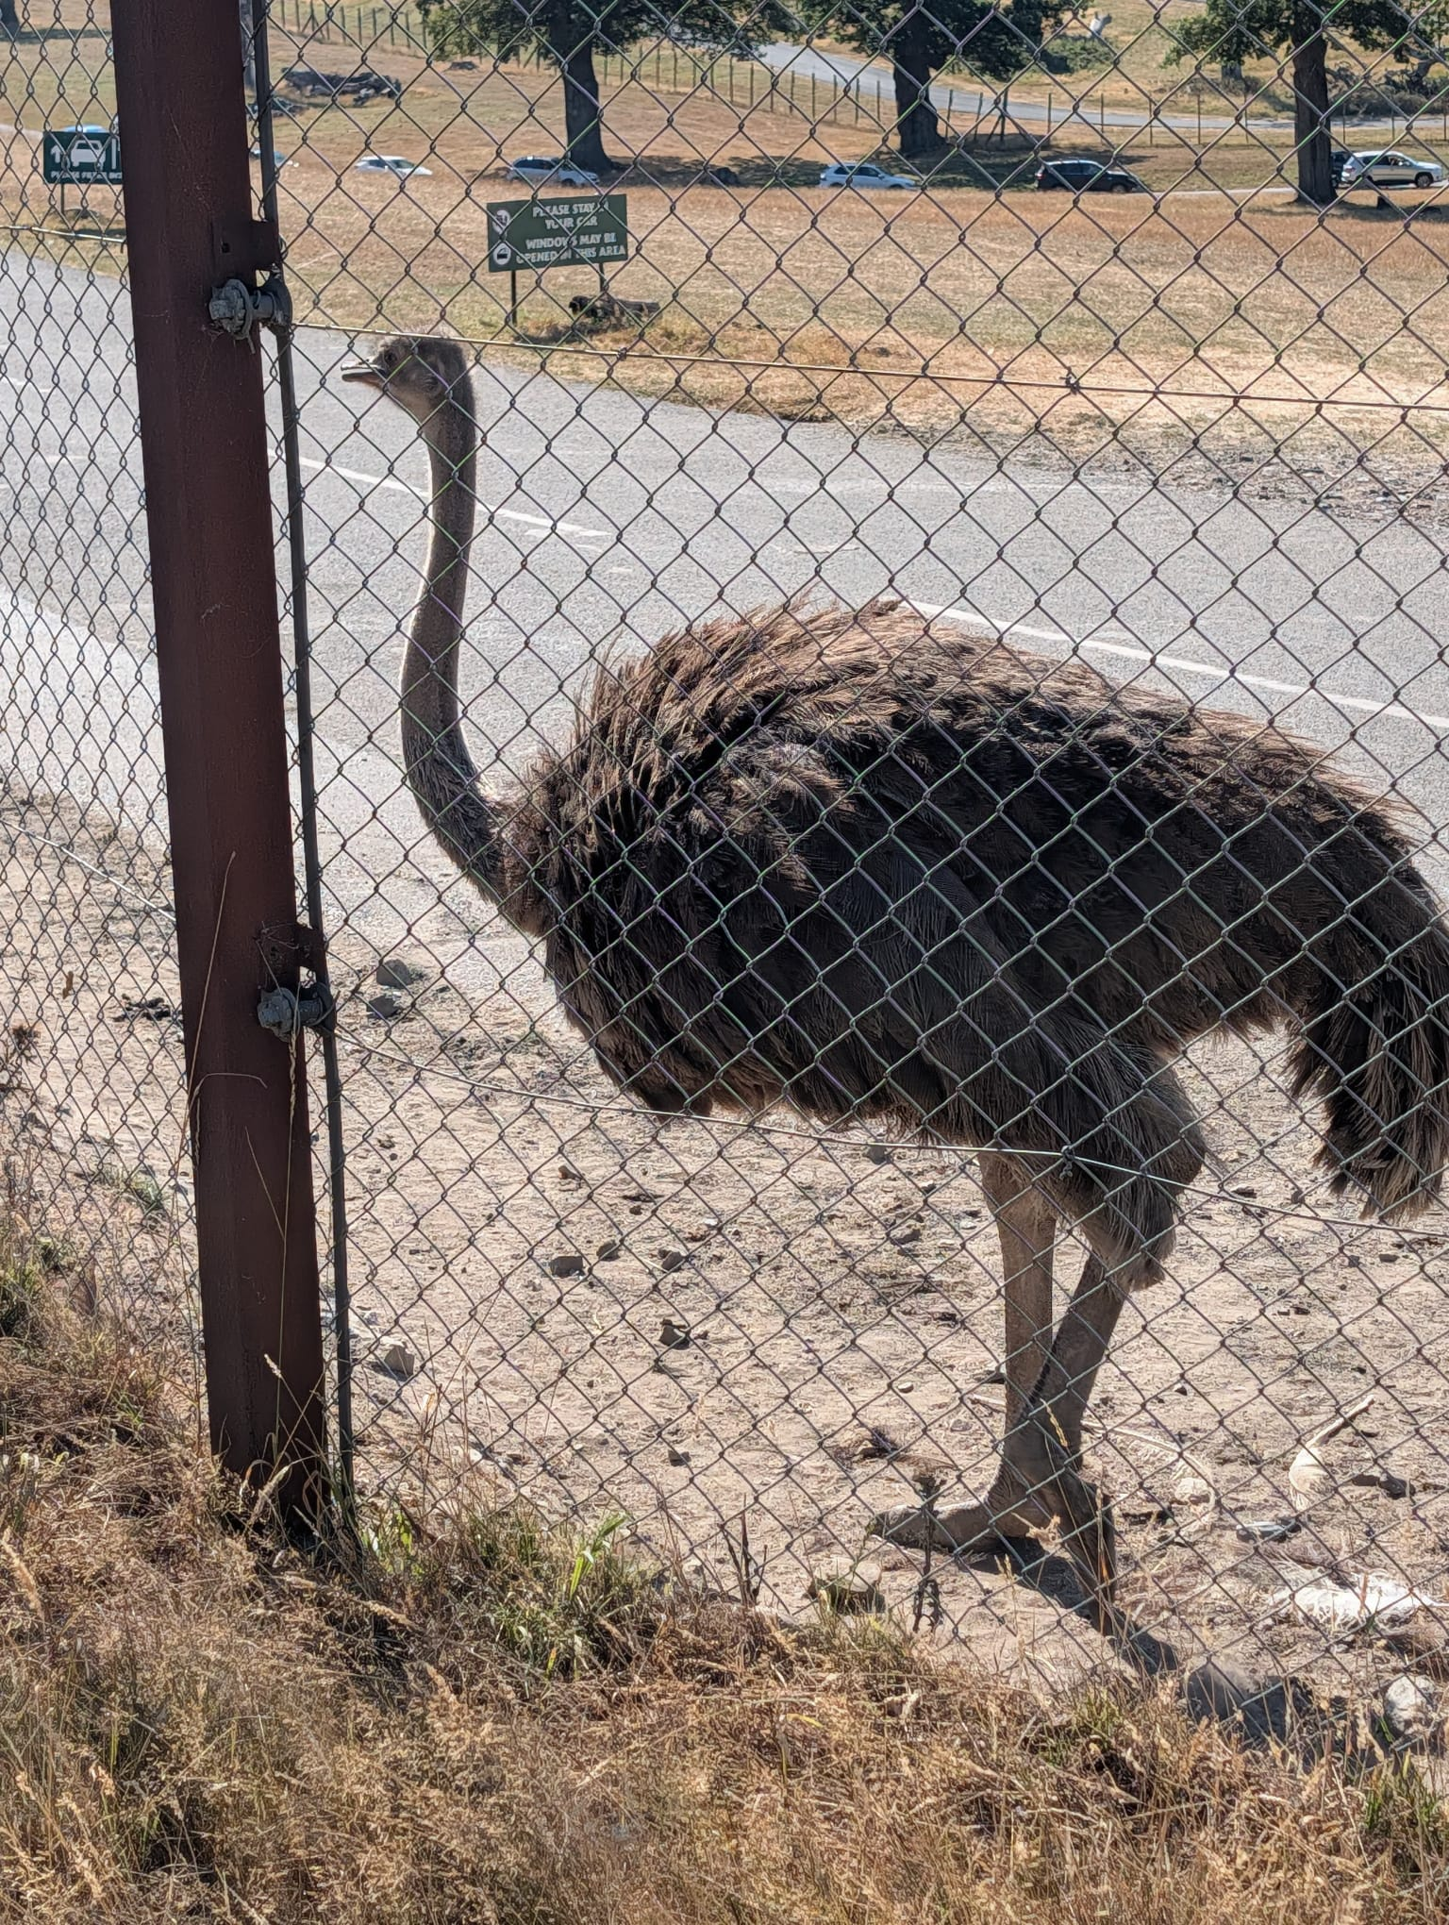
Animals

Slide 5
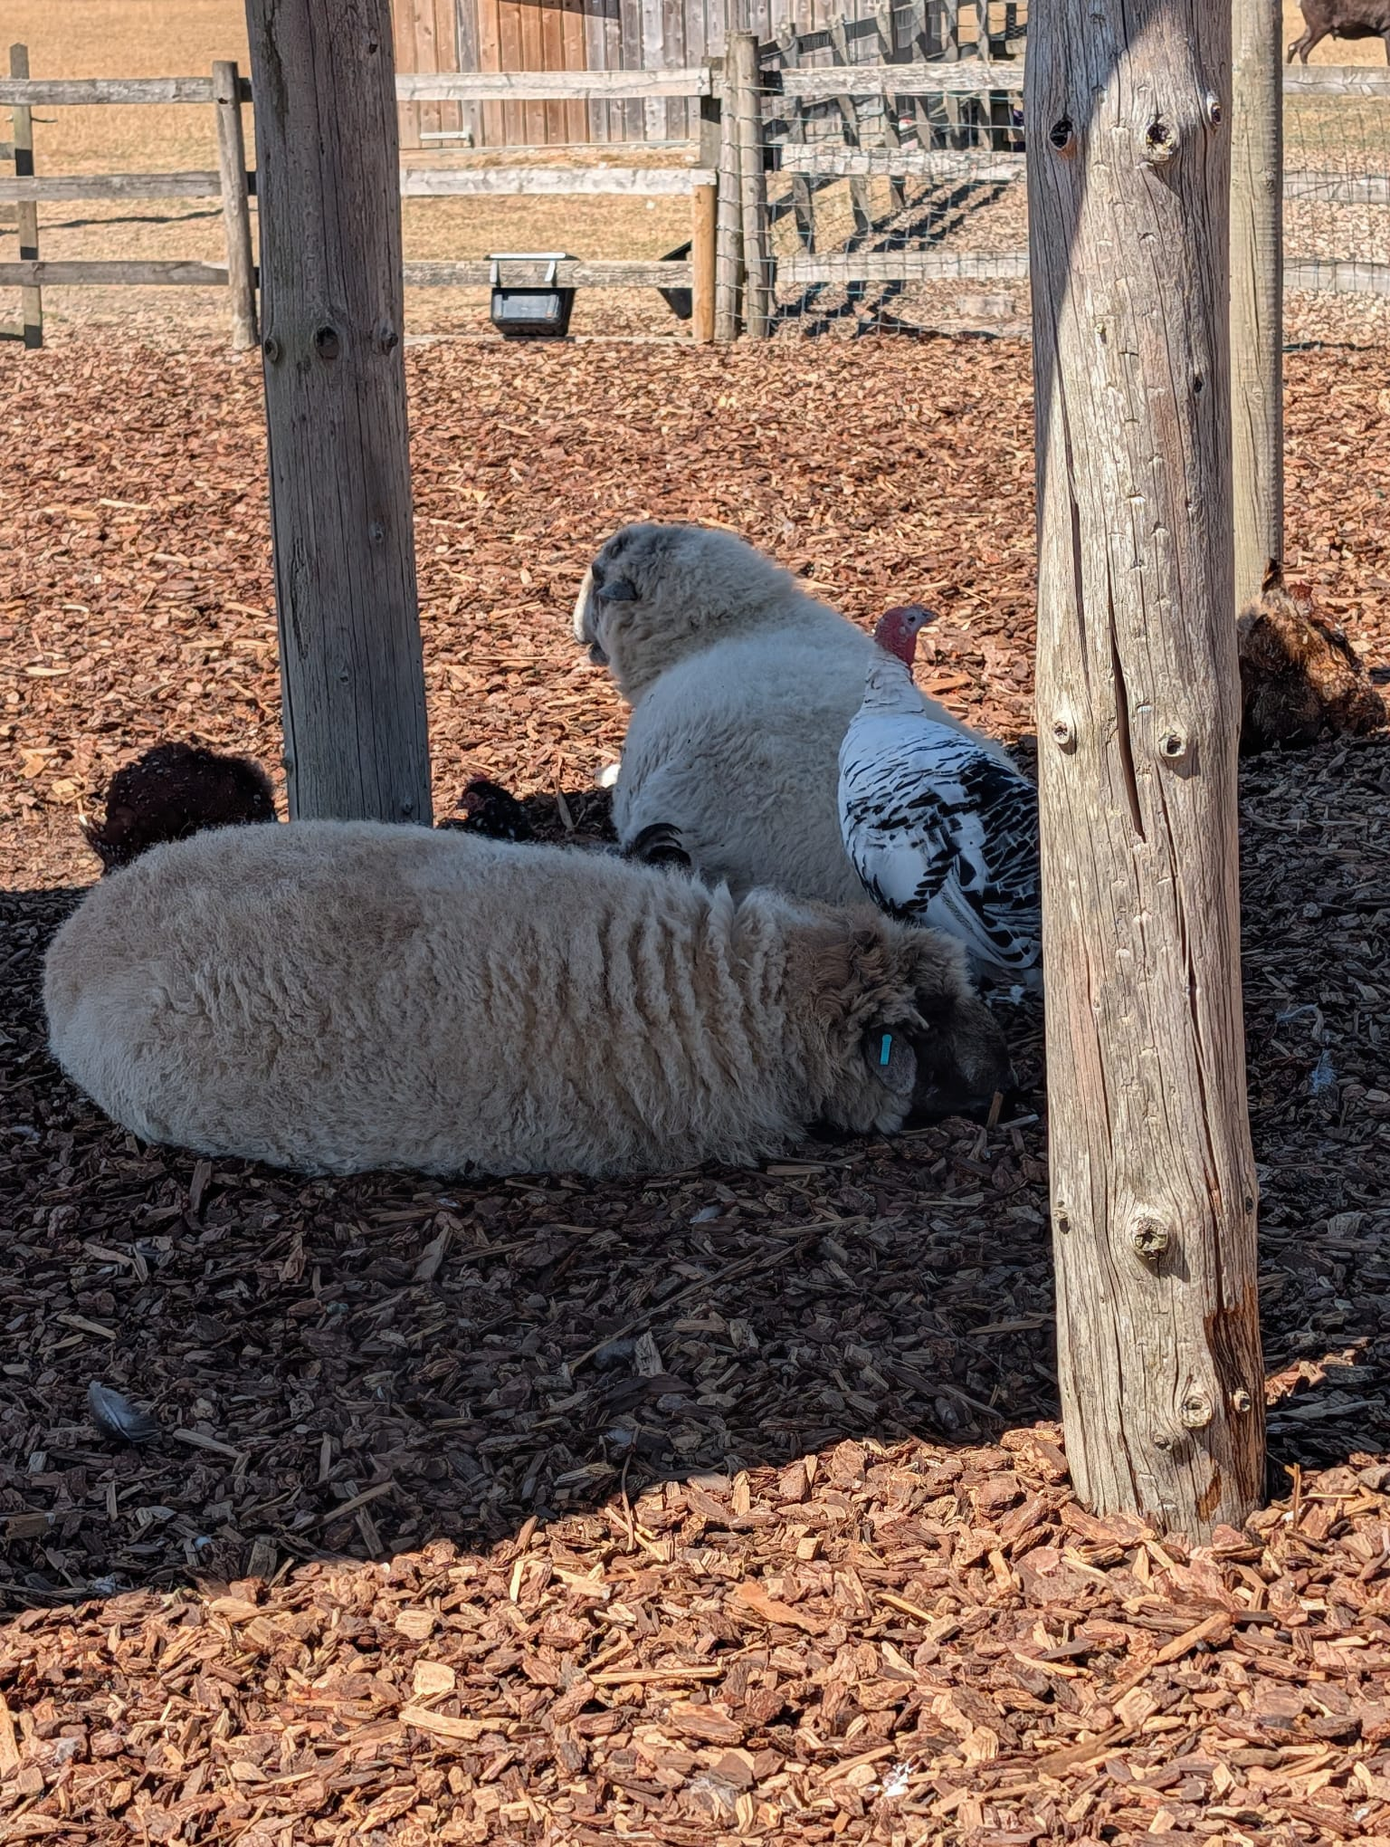
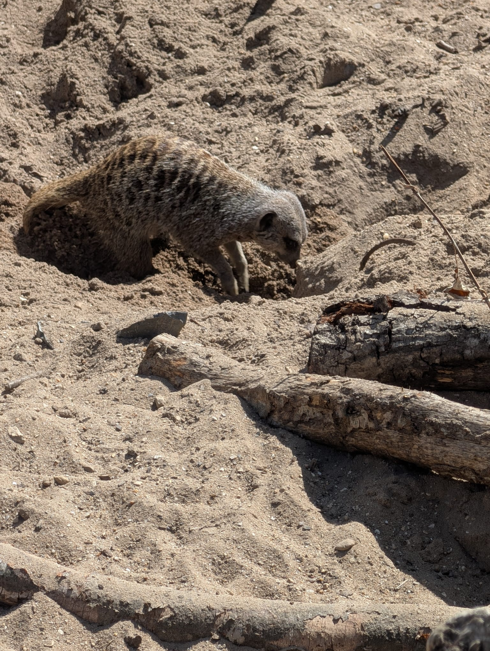
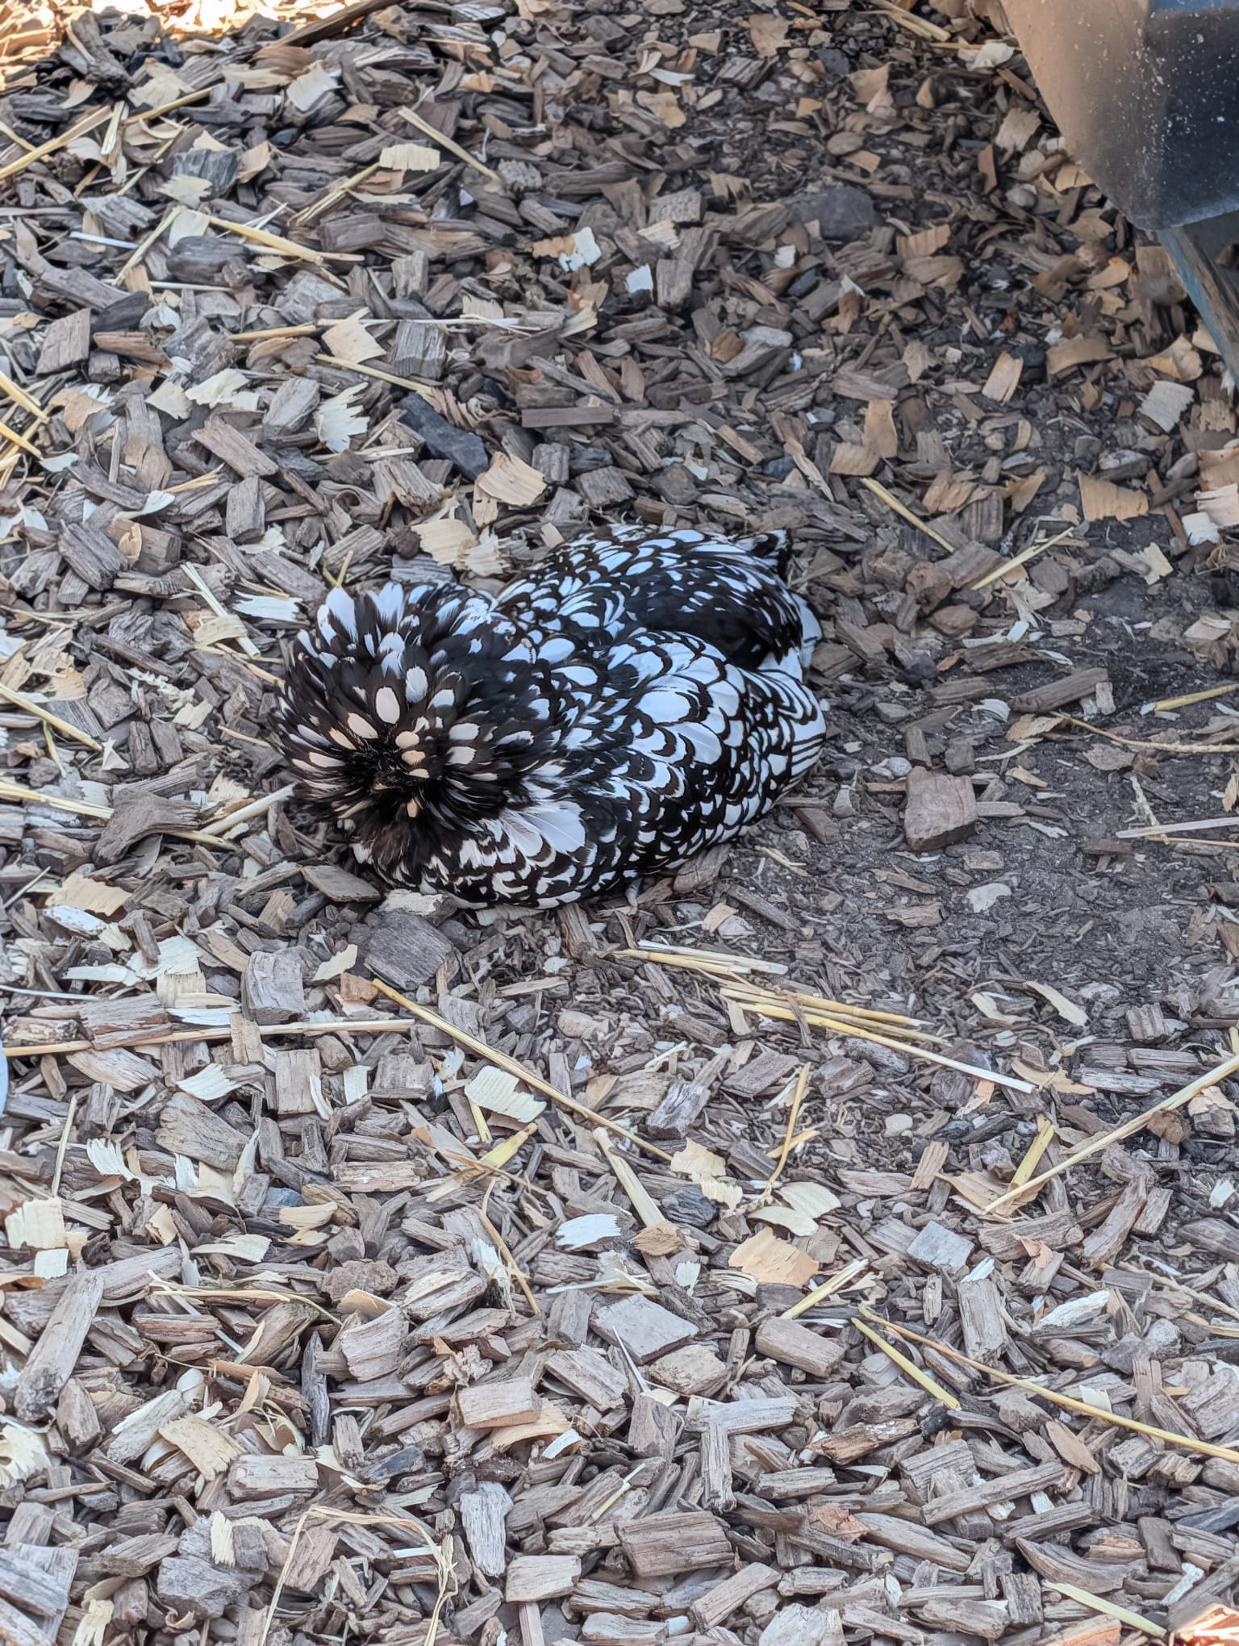
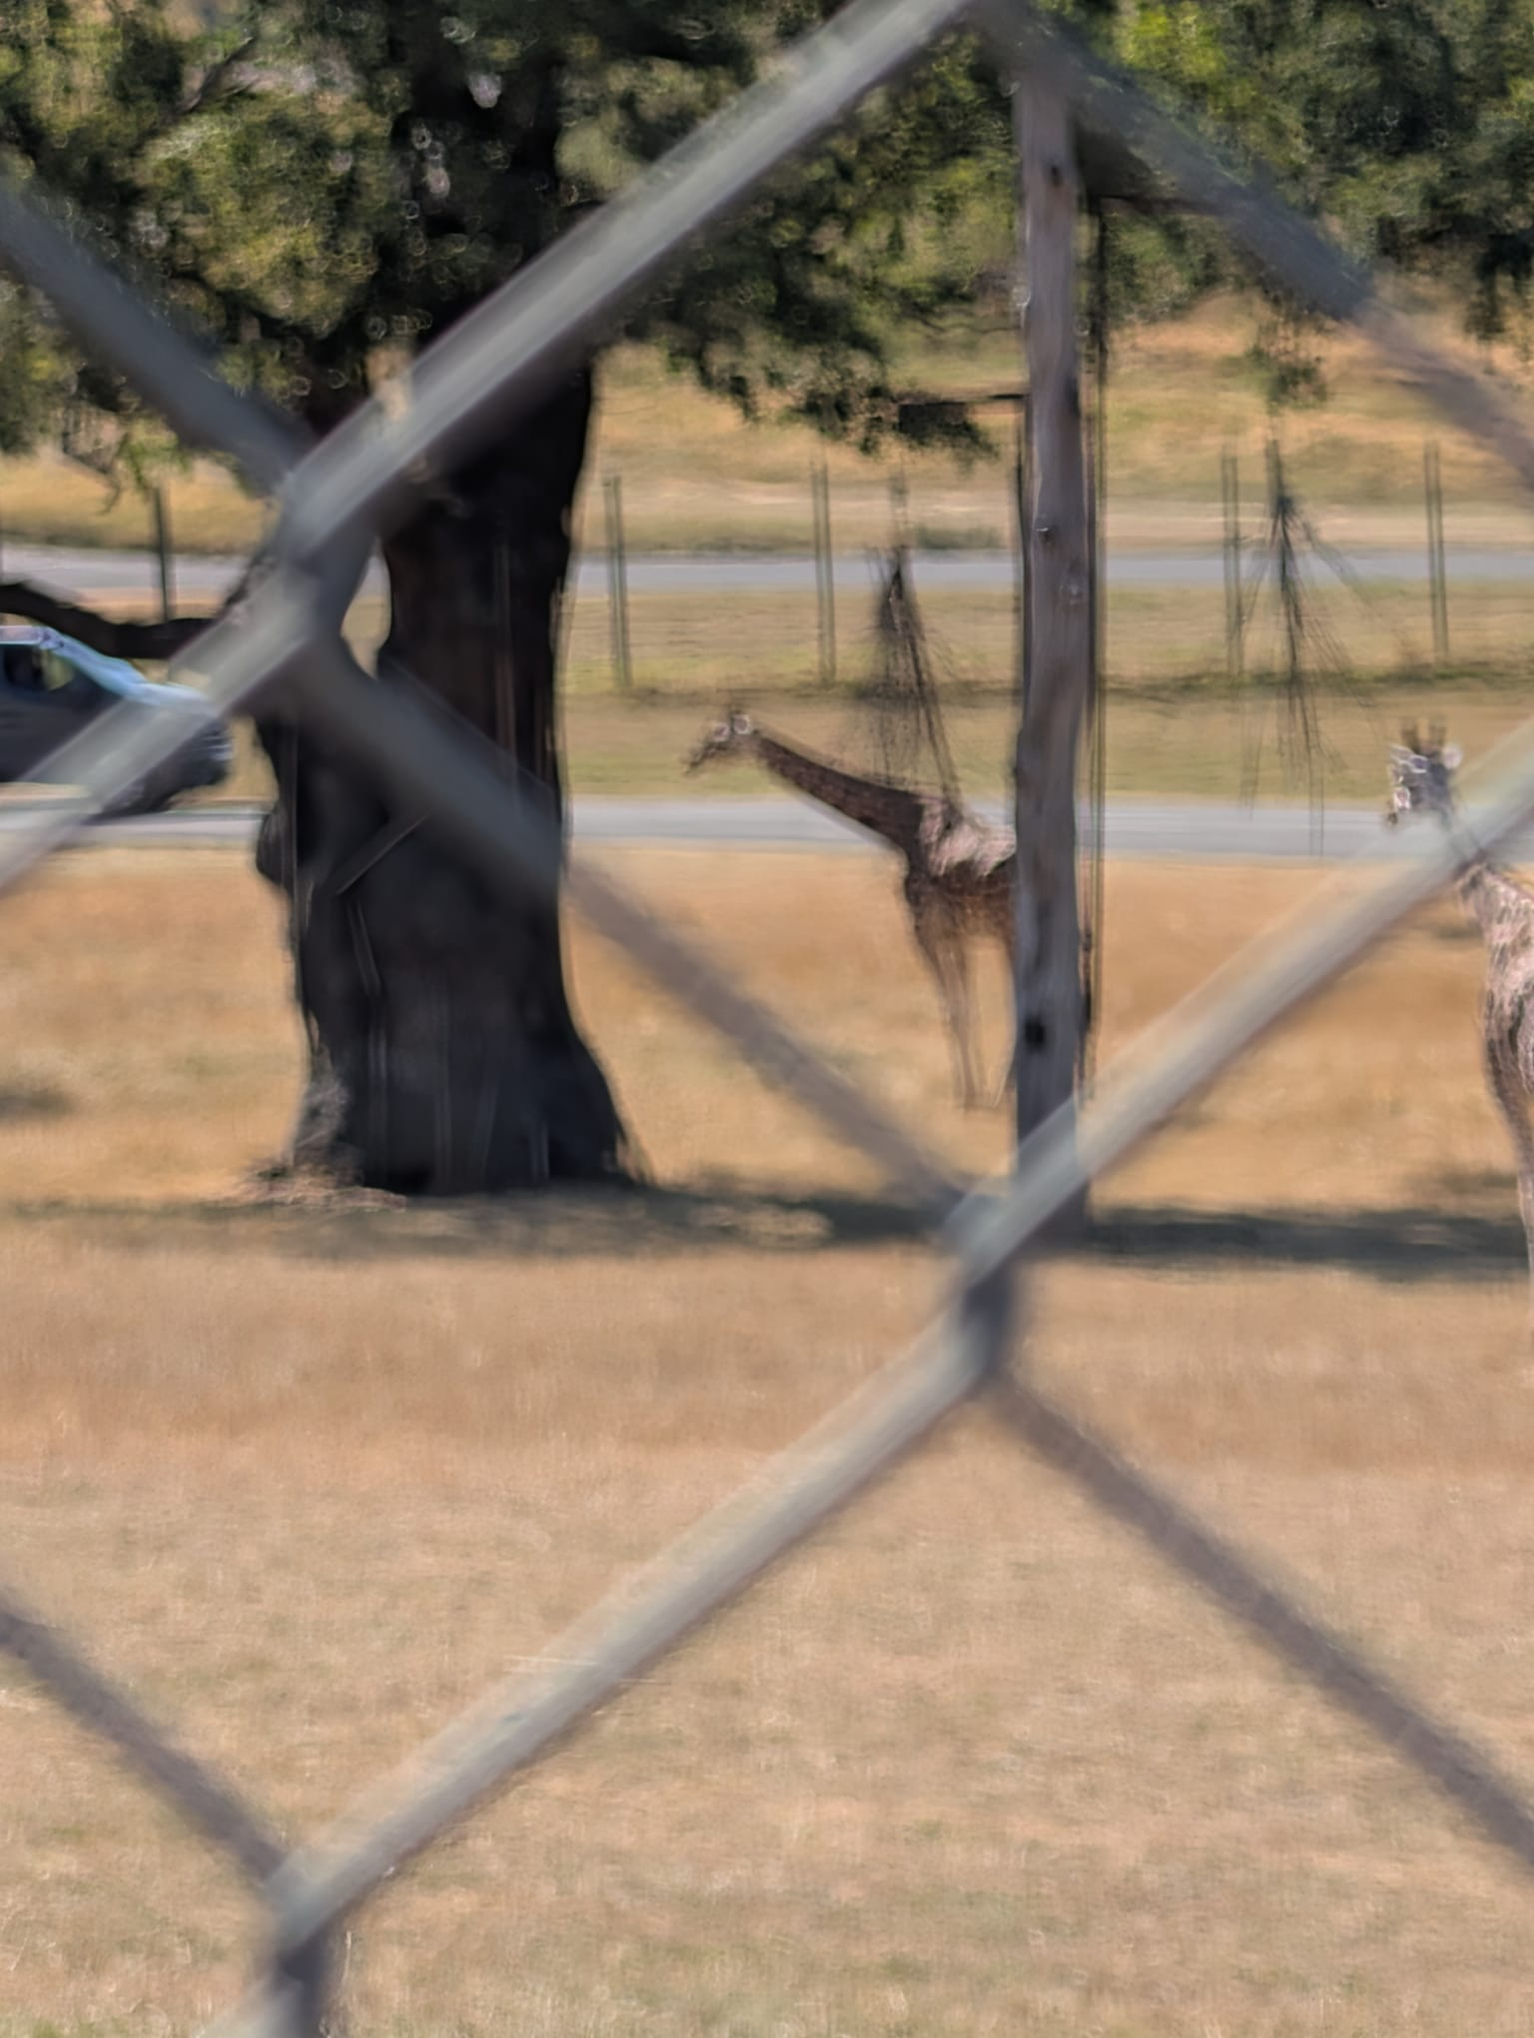
animals

Slide 6
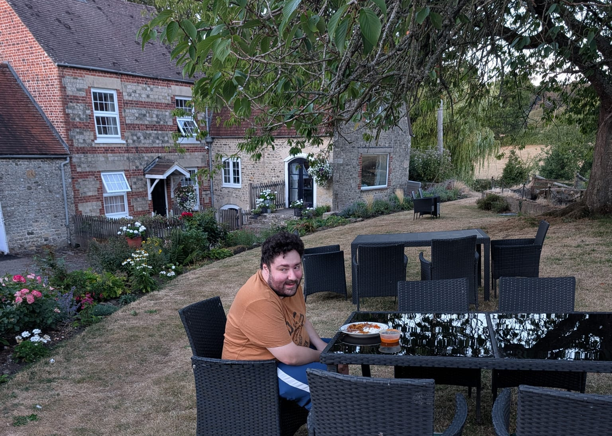
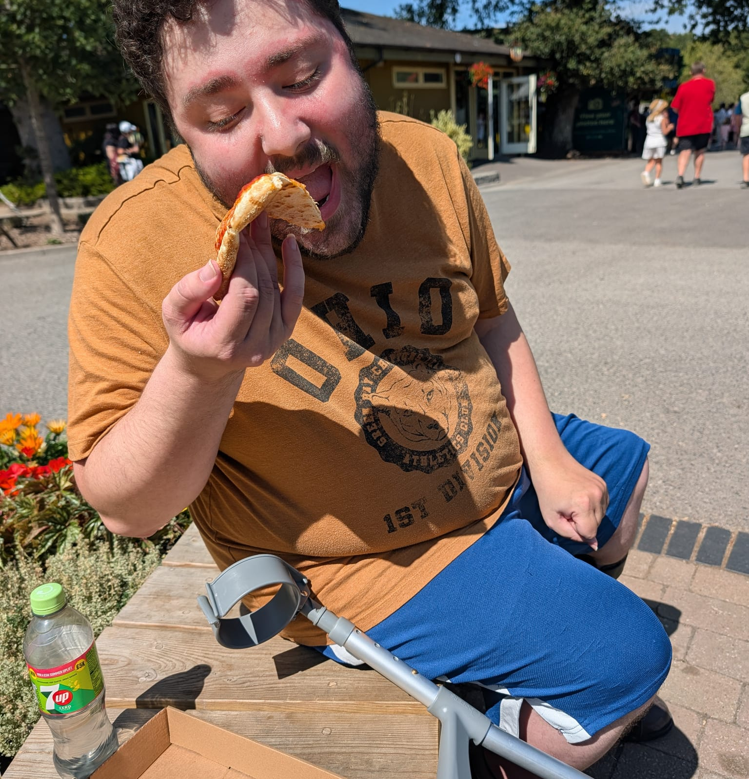
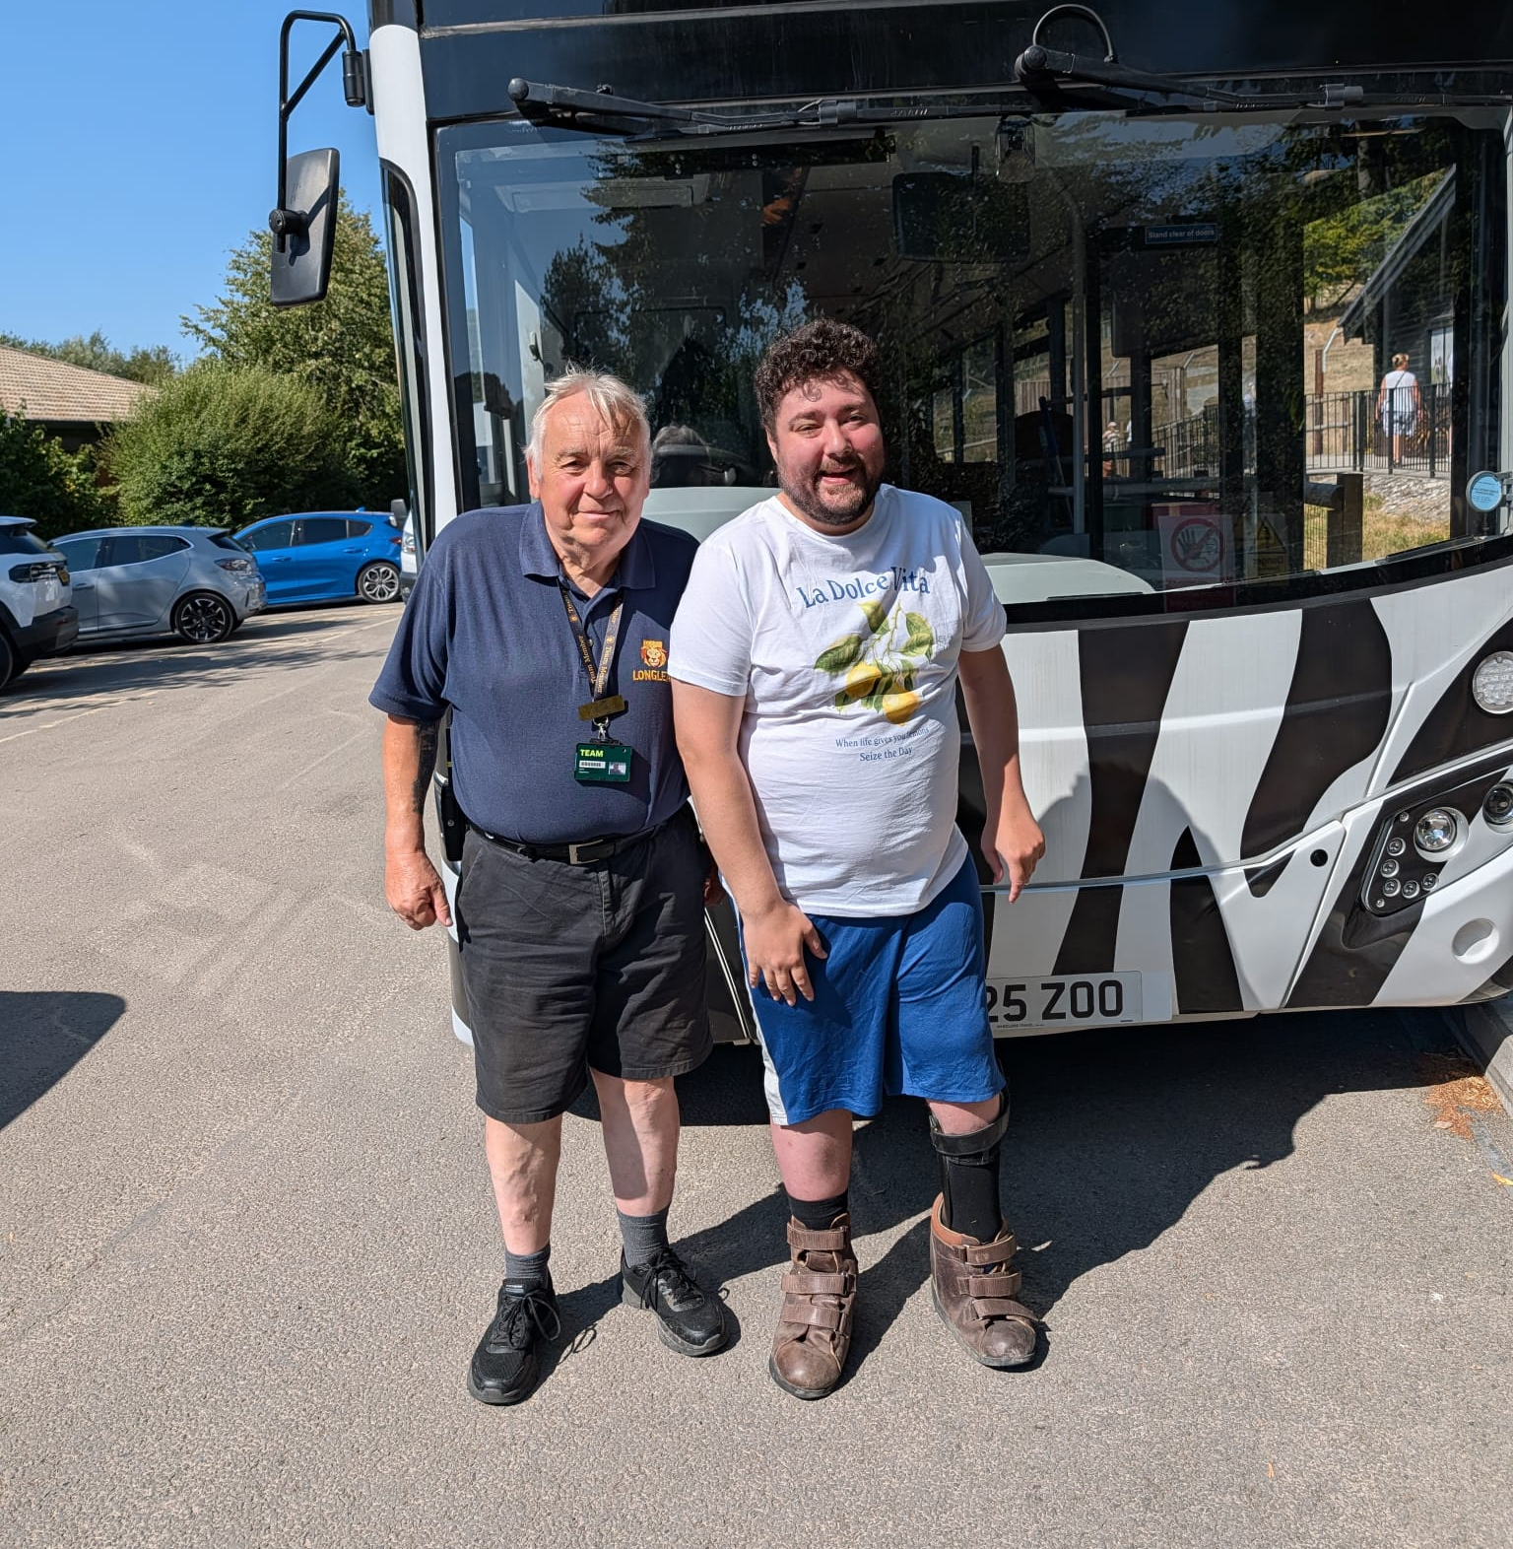
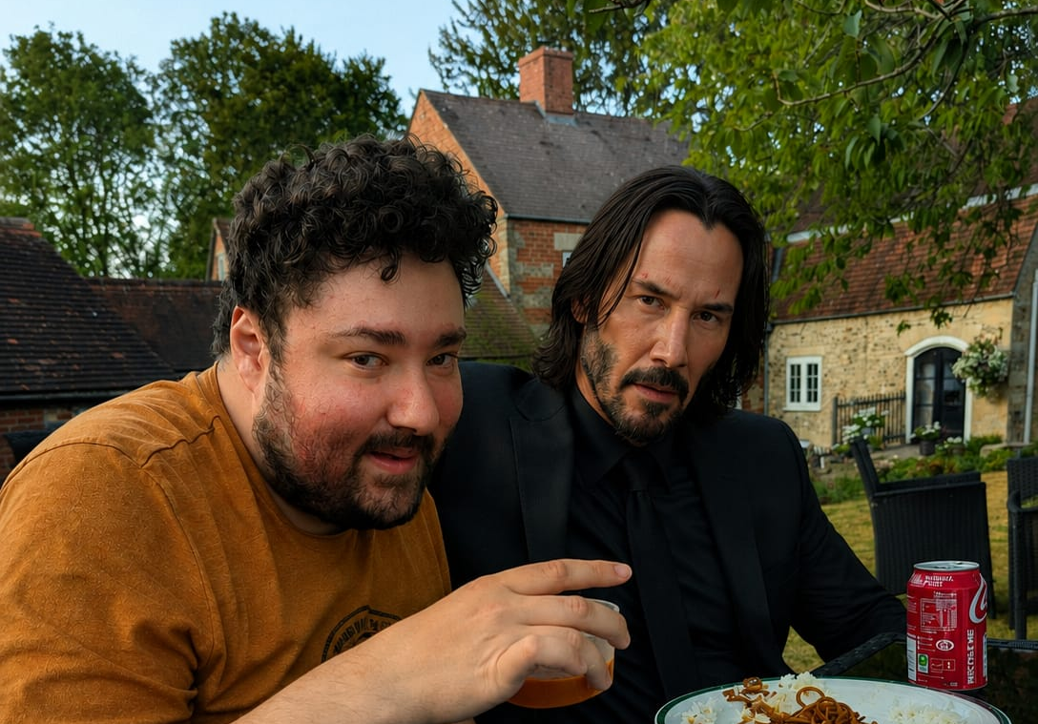
Great company & great food
Longleat had many great areas to eat food, Max particularly enjoyed the pizza!
Whilst eating dinner at his accommodation Max had an unexpected visitor… May or may not be the work of Chat GPT.
A great experience with Longleat Safari Bus, Max and Tony thanked the driver!

Slide 7
Conclusion
Max really enjoyed the planning and preparation for this trip. From having conversations with Chloe, GAC Administrator and his mother, Max was able to plan and take part in all his chosen activities!
Tony was great company and ensured to protect Max’s dignity and supported him as needed. This support ranged from physical, tangible, emotional, informative and practical.
At Gelli Aur Care we support Residents to take part in all activities that they wish to do, within reason. By involving Max in the planning of his trip, he was able to customise his experience and learn money management.
Max is already planning his next trip to Longleat! See you soon!

